Slide 1
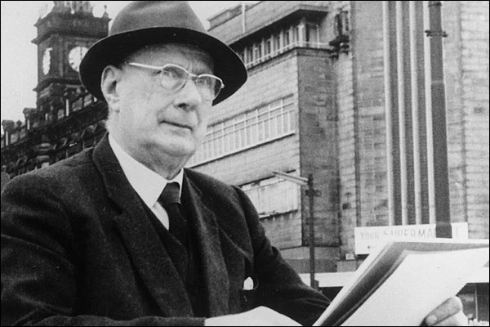
L S Lowry Born: 1st November 1887 Died: 23rd February 1976

Slide 2
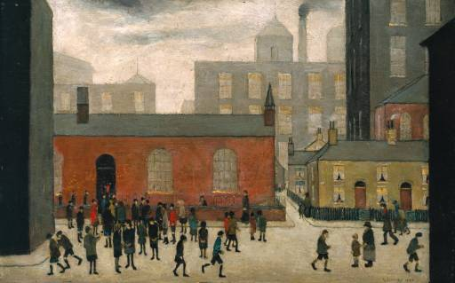
L S Lowry Coming Out of School 1927

Slide 3
L S Lowry Coming Out of School 1927
Like many of Lowry's
pictures this is not a
depiction of a particular
place, but is based on
recollections of a school
seen in Lancashire.

Slide 4
L S Lowry Coming Out of School 1927
'I stood in the gallery
marvelling at the accuracy
of the mirror that this to
me unknown painter had
held up to the bleakness,
the obsolete shabbiness,
the grimy fogboundness,
the grimness of northern
industrial England.'

Slide 5
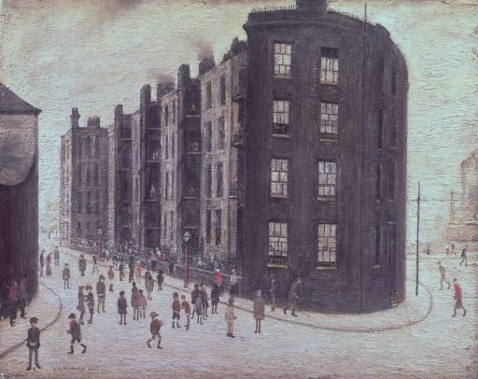
L S Lowry Dwelling, Ordsall Lane, Salford 1927

Slide 6
L S Lowry Dwelling, Ordsall Lane, Salford 1927
Lowry was fascinated by
buildings. For him they
evoked the lives of their
occupants.
“My favourite places were
the houses built around
factories. They just
attracted me more than
the others.”

Slide 7
L S Lowry Dwelling, Ordsall Lane, Salford 1927
Revisiting Orsdall Lane in
the 1960s Lowry
remembered “scores of
little kids who hadn't had
a wash for weeks would
come and stand around
me. And there was a niff,
too.”

Slide 8
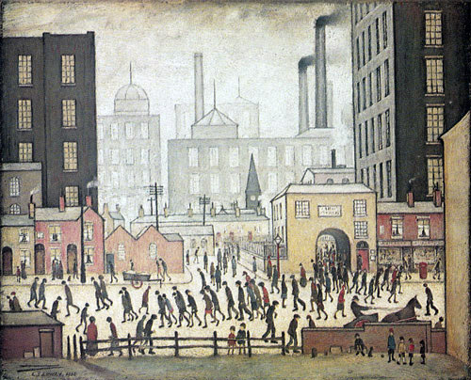
L S Lowry Coming From The Mill, 1930

Slide 9
L S Lowry Coming From The Mill, 1930
The tall buildings and the
smoking chimneys are
present, as are the busy
figures in the foreground.
The stooped figures are
shown trudging home
from the mill after a day at
work.

Slide 10
L S Lowry Coming From The Mill, 1930
Lowry would create a very
pale background against
which to place his figures,
thus making them stand
out.
Another typical motif of
Lowry’s painting is the
church depicted amongst
the factories.

Slide 11
L S Lowry Coming From The Mill, 1930
The painting tells a story.
Can you identify some key
characters? Where are
they going? Where have
they been? Why are they
stooped?
Think about what it must
have been like to live in
this industrial era.

Slide 12
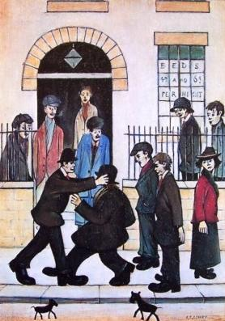
L S Lowry A Fight, 1935

Slide 13
L S Lowry A Fight, 1935
This is a humorous
painting, that shows
Lowry’s love of slapstick.
The faces of the onlookers
show amusement rather
than horror, apart from
the woman portrayed in
the painting who wears a
worried impression.

Slide 14
L S Lowry A Fight, 1935
Why do you think the men
are fighting?
Playful fights sometimes
escalate, does the woman
in the picture sense this?
Create a story around the
image. How did it start
and how will it end?

Slide 15
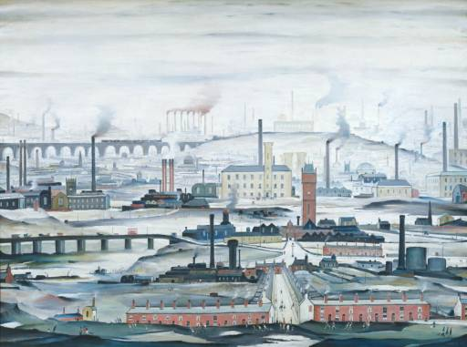
L S Lowry An Industrial Landscape 1955

Slide 16
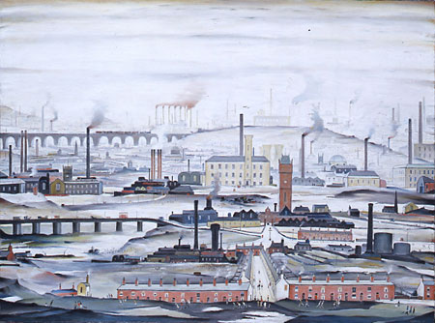
L S Lowry An Industrial Landscape 1955
Although it is an imaginary
composition, elements of
the view are recognisable
as real places. For
example, the Stockport
Viaduct, which constantly
haunted the artist, can be
seen in the top left of the
picture

Slide 17
L S Lowry An Industrial Landscape 1955
As if to emphasise the
human presence in this
overwhelming, blackened
city, Lowry focuses in on a
small street in the
foreground, almost
inviting the viewer
to join the small group of
people going about their
business.

Slide 18
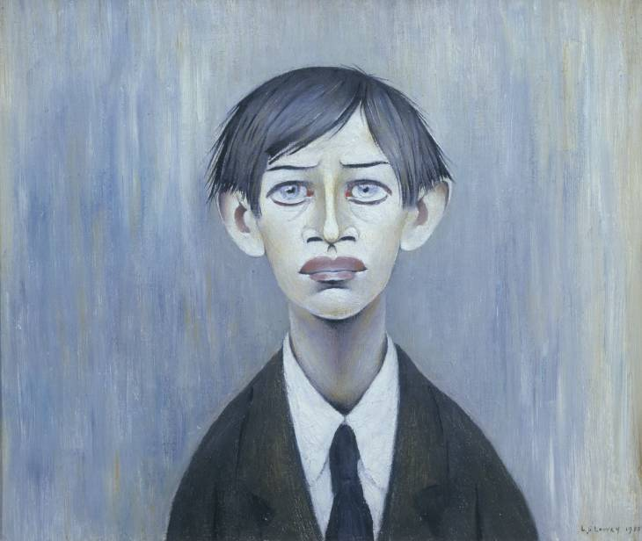
L S Lowry A Young Man 1957

Slide 19
L S Lowry A Young Man 1957
“The head was done from
my recollection of a young
man I saw once in a
Manchester park - a good
while ago. He interested
me very much at the time
and stayed in my mind in a
vague sort of way ever
since.”

Slide 20
L S Lowry A Young Man 1957
He gave me the impression
that something had very
badly gone wrong in his life
though he gave no inkling of
what it was in a fairly long
conversation. He was totally
disinterested in anything at
all and yet was, to me most
interesting .

Slide 21
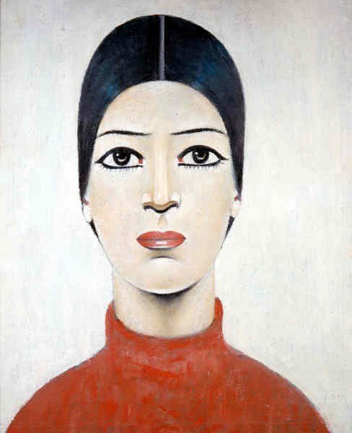
L S Lowry Portrait of Ann, 1957

Slide 22
L S Lowry Portrait of Ann, 1957
It was painted in 1957 when
Lowry was beginning to
become known as an artist.
This painting surprised
many people because
they only thought of
Lowry as the artist from
the North who painted
industrial landscapes.

Slide 23
L S Lowry Portrait of Ann, 1957
Who Ann is exactly is
unknown.
There are many theories,
but it is unlikely that Ann
is a specific person who
Lowry knew and painted
(although sometimes
Lowry would pretend that
it was)

