Slide 1
Qu’est-ce qui ne va pas ? (What’s the Matter?)

Slide 2
Aim
I can follow a simple story, using known language to help me understand unfamiliar parts.
Success Criteria
I can follow a simple story.
I can join in with repeated phrases.
I can recognise known words and use them to help with new language.
I can ask and answer questions about health.

Slide 3
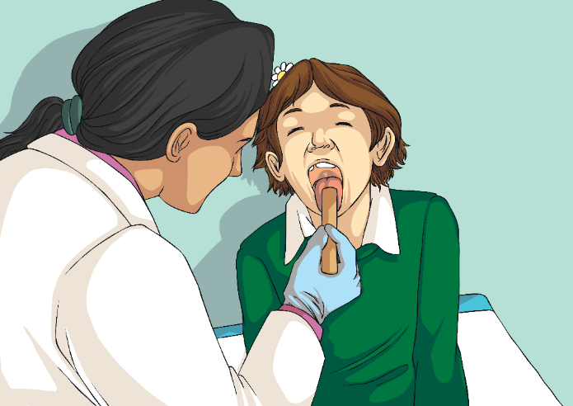
Going to the Doctors
Click play buttons throughout to hear phrases and words.
What happens when you go to the Doctors?
Tell your partner.

Slide 4
Lisons une histoire ! (Let’s Read a Story!)
Here is a story about Madame Santé’s tiring day.
Look out and listen for words you know – they will help you understand the new language.
Click on the doctor to start the story.

Slide 5
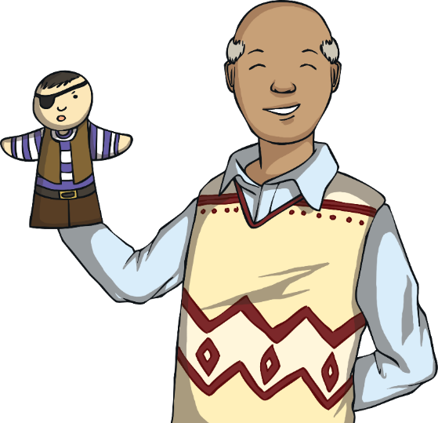
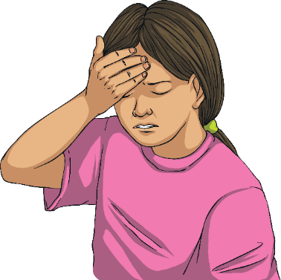
Qu’est-ce qui ne va pas ? (What’s the Matter?)
Click play buttons throughout to hear phrases and words.
Qu’est-ce qui ne va pas ?
J’ai mal à la tête.

Slide 6
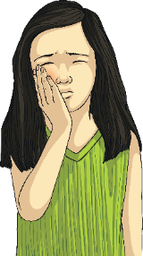
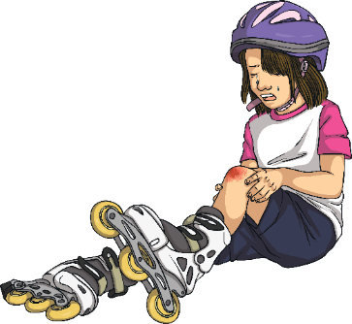
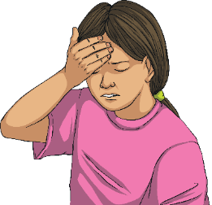
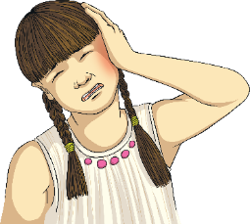
Qu’est-ce qui ne va pas ? (What’s the Matter?)
Think back to the story. What did each child start their sentence with to say what was wrong?
J’ai mal au genou.
J’ai mal à la tête.
J’ai mal à l’oreille.
J’ai mal aux dents.
What do you think the highlighted words mean?
Why are they different in each sentence?

Slide 7
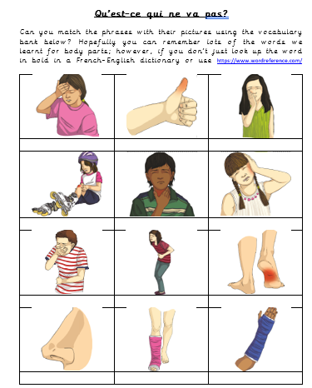
Au cabinet médical (At the Doctor’s)
Task 1: Can you match the phrases in the vocabulary bank with their pictures?
Extension: Maybe you could make up a role play with someone at home to practise some of the phrases – one person can pretend to feel poorly and the other can pretend to be the doctor who helps them.
You might like to read the transcript of the story at the doctor’s to help you remember what the doctor(and patients) would say. This is on the website for you to use and may also help with your translations.

Slide 8
Aim
I can follow a simple story, using known language to help me understand unfamiliar parts.
Success Criteria
I can follow a simple story.
I can join in with repeated phrases.
I can recognise known words and use them to help with new language.
I can ask and answer questions about health.

Slide 10
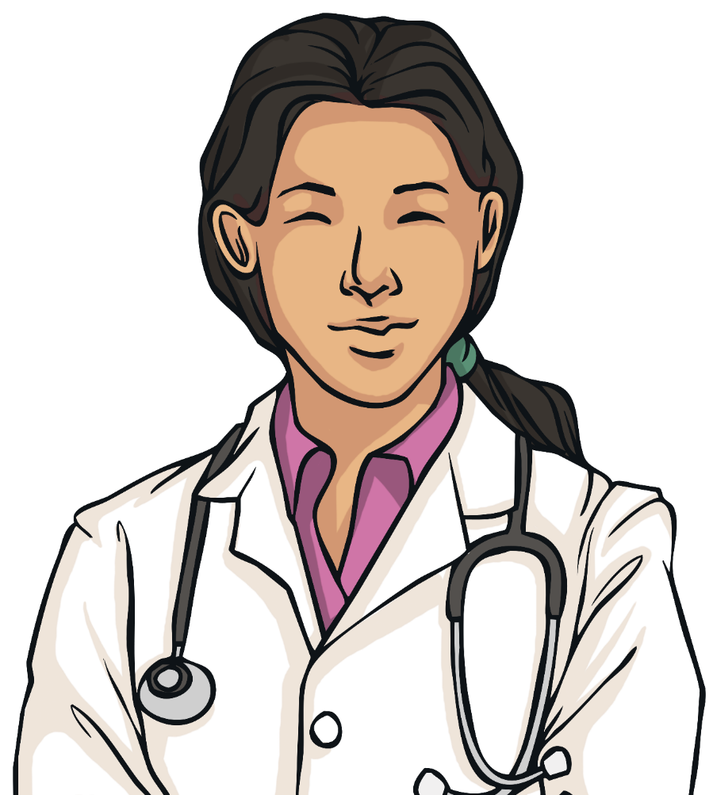
Une journée fatigante pour Docteur Santé.
Notes:
This is Dr Santé. She is asleep.

Slide 11
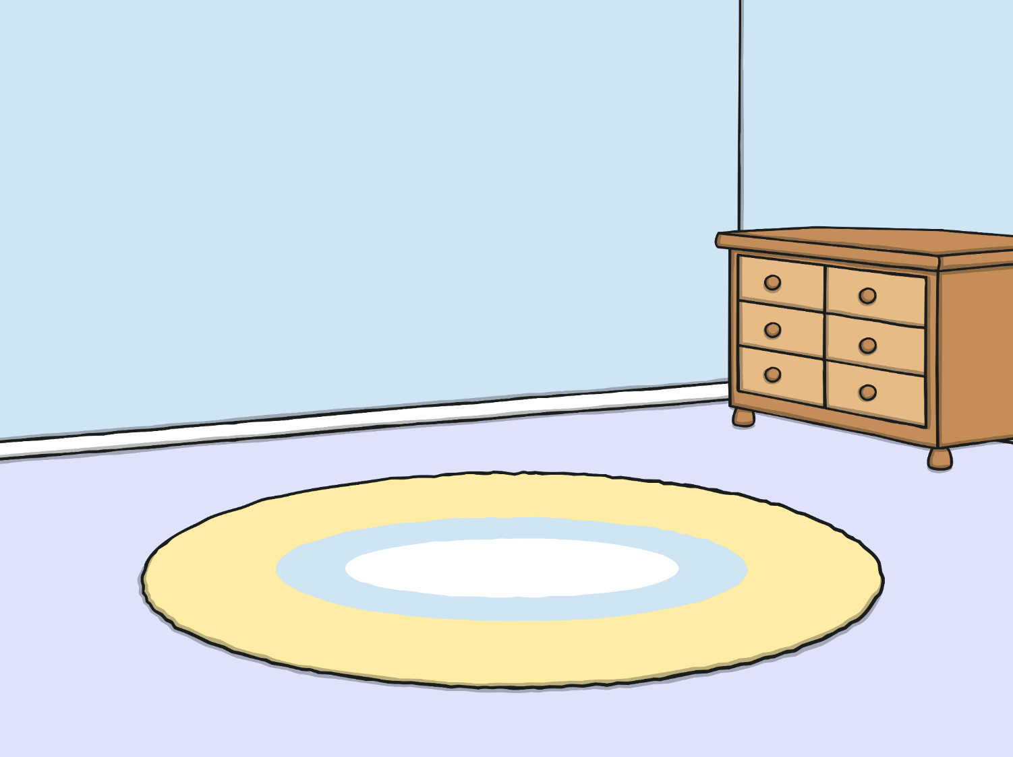
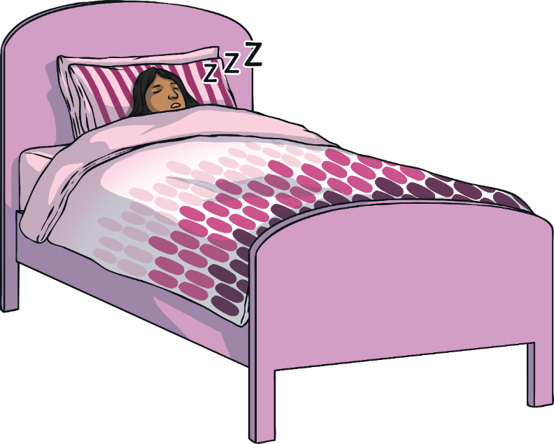
Voici Docteur
Santé. Elle dort.
Notes:
This is Dr Santé. She is asleep.

Slide 12
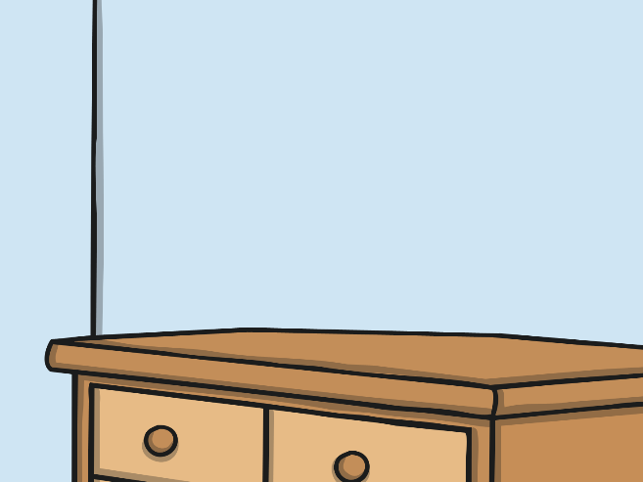
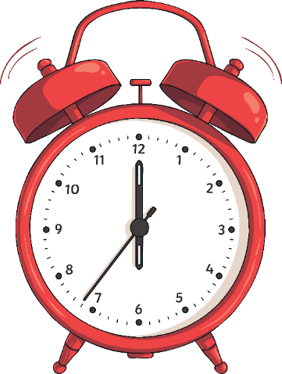
À six heures du matin, le réveil sonne.
Notes:
At six o’clock, her alarm clock rings.

Slide 13
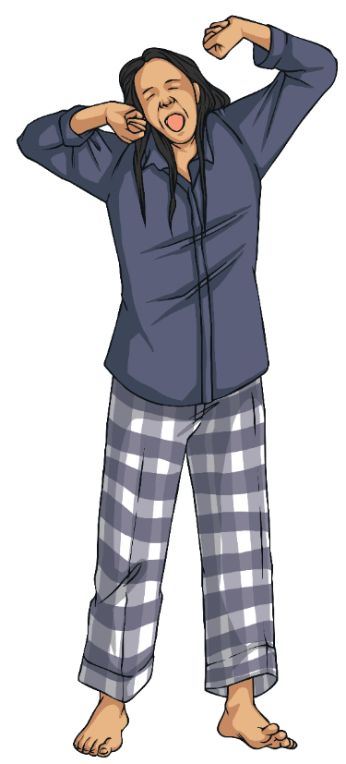
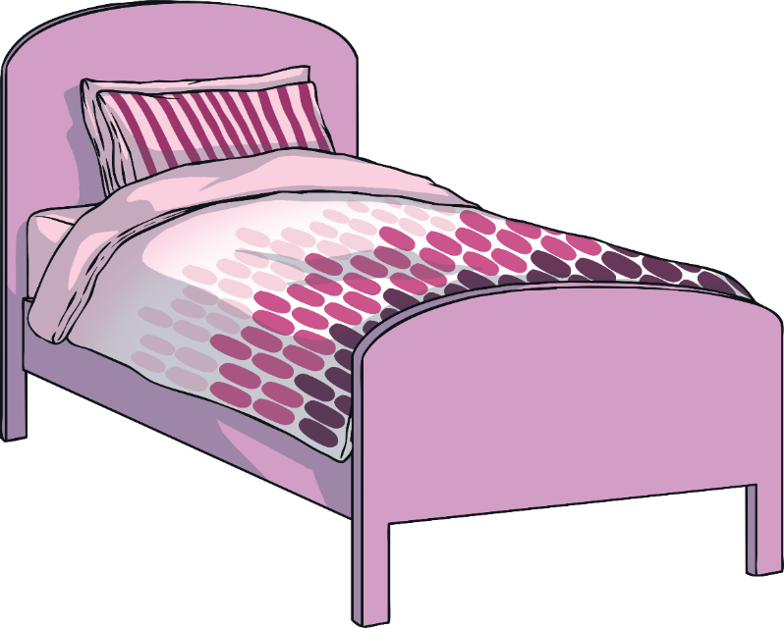
Elle se lève. Elle est fatiguée.
Notes:
She gets up. She is tired.

Slide 14
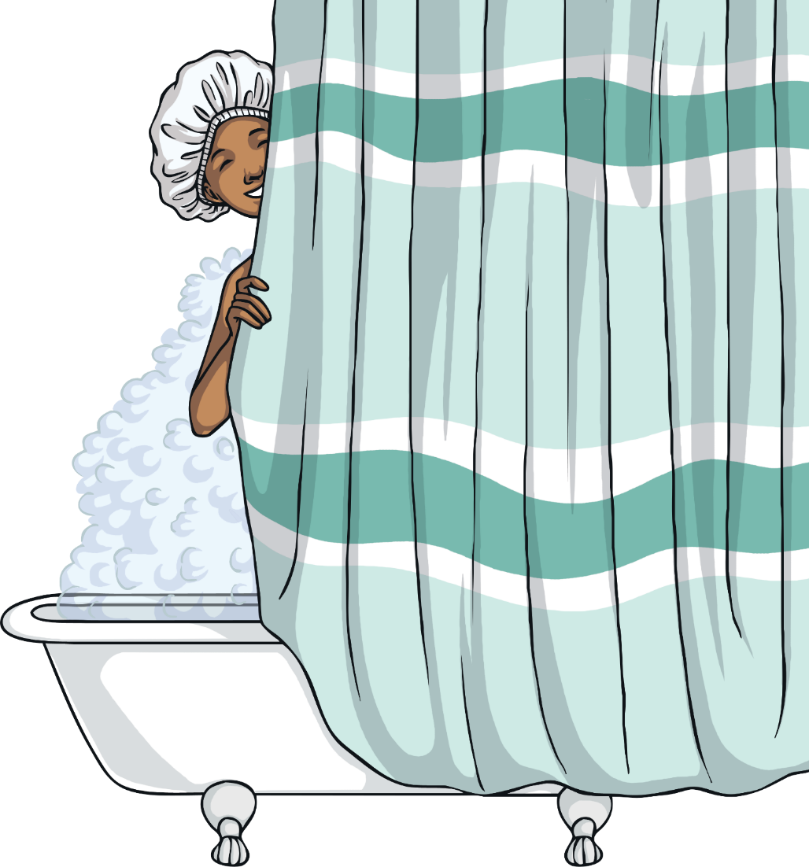
Elle prend une douche.
Notes:
She takes a shower.

Slide 15
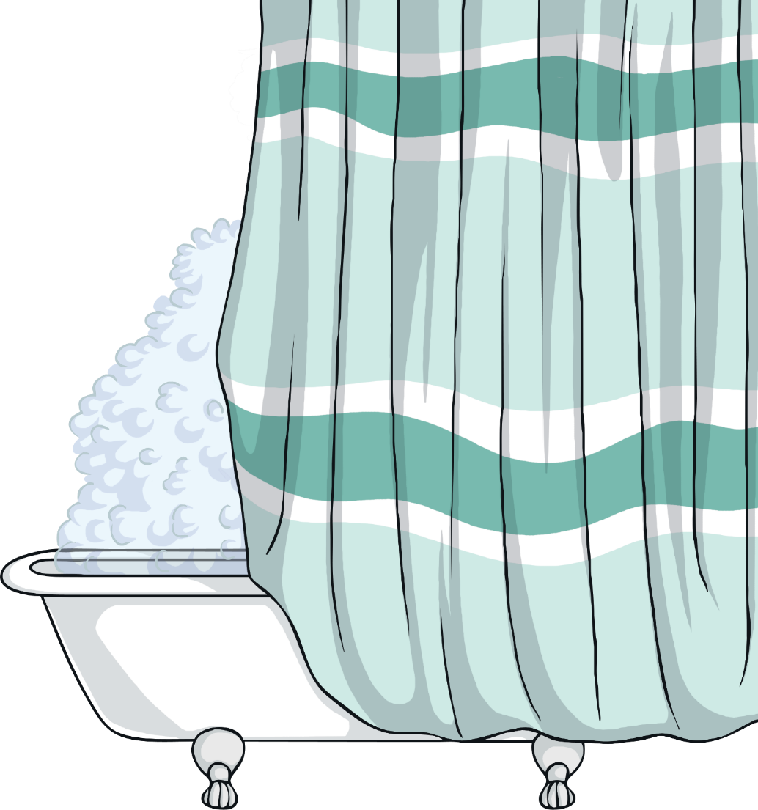
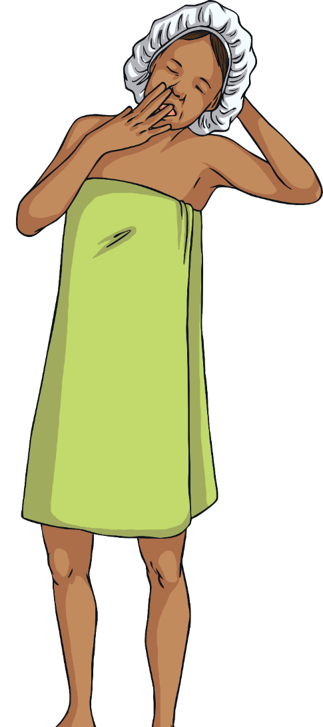
Mais elle est toujours fatiguée.
Notes:
But she is still tired.

Slide 16
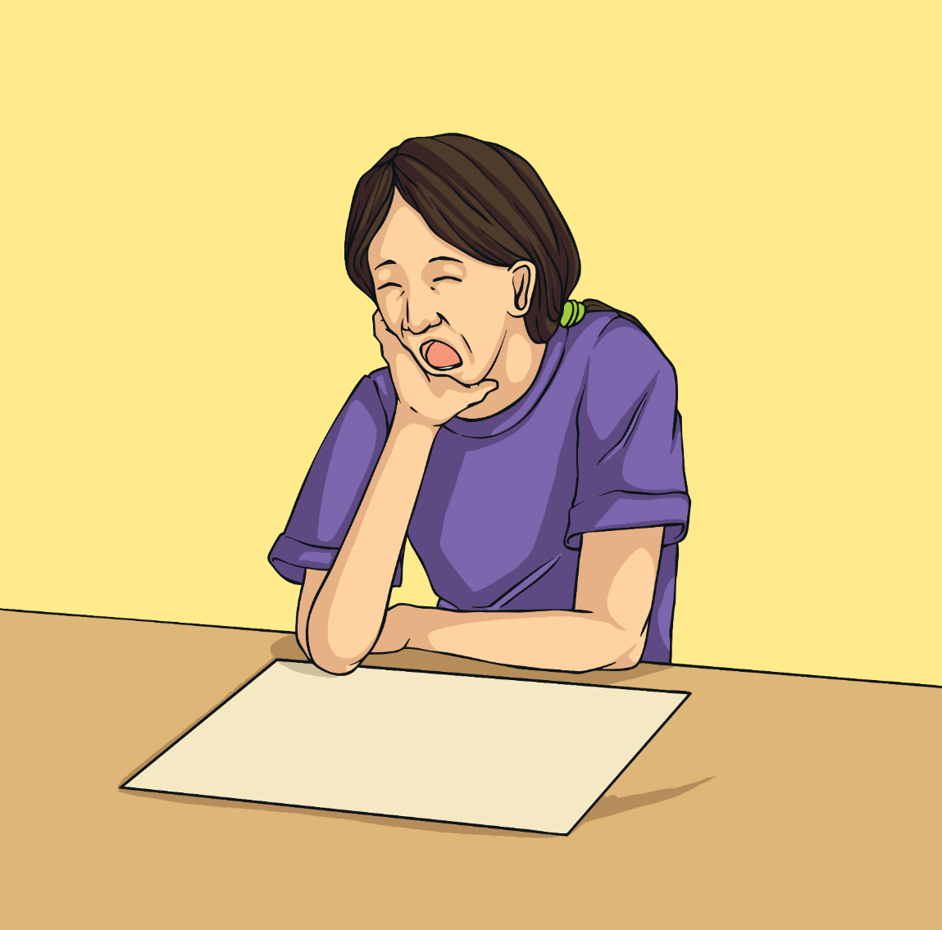
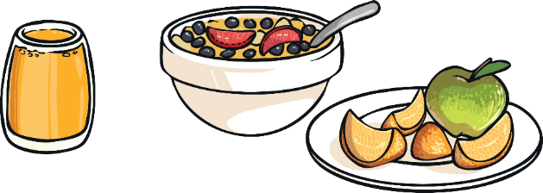
Puis, elle mange son petit déjeuner…
…mais elle est toujours fatiguée.
Notes:
Next, she eats her breakfast…but she is still tired.

Slide 17
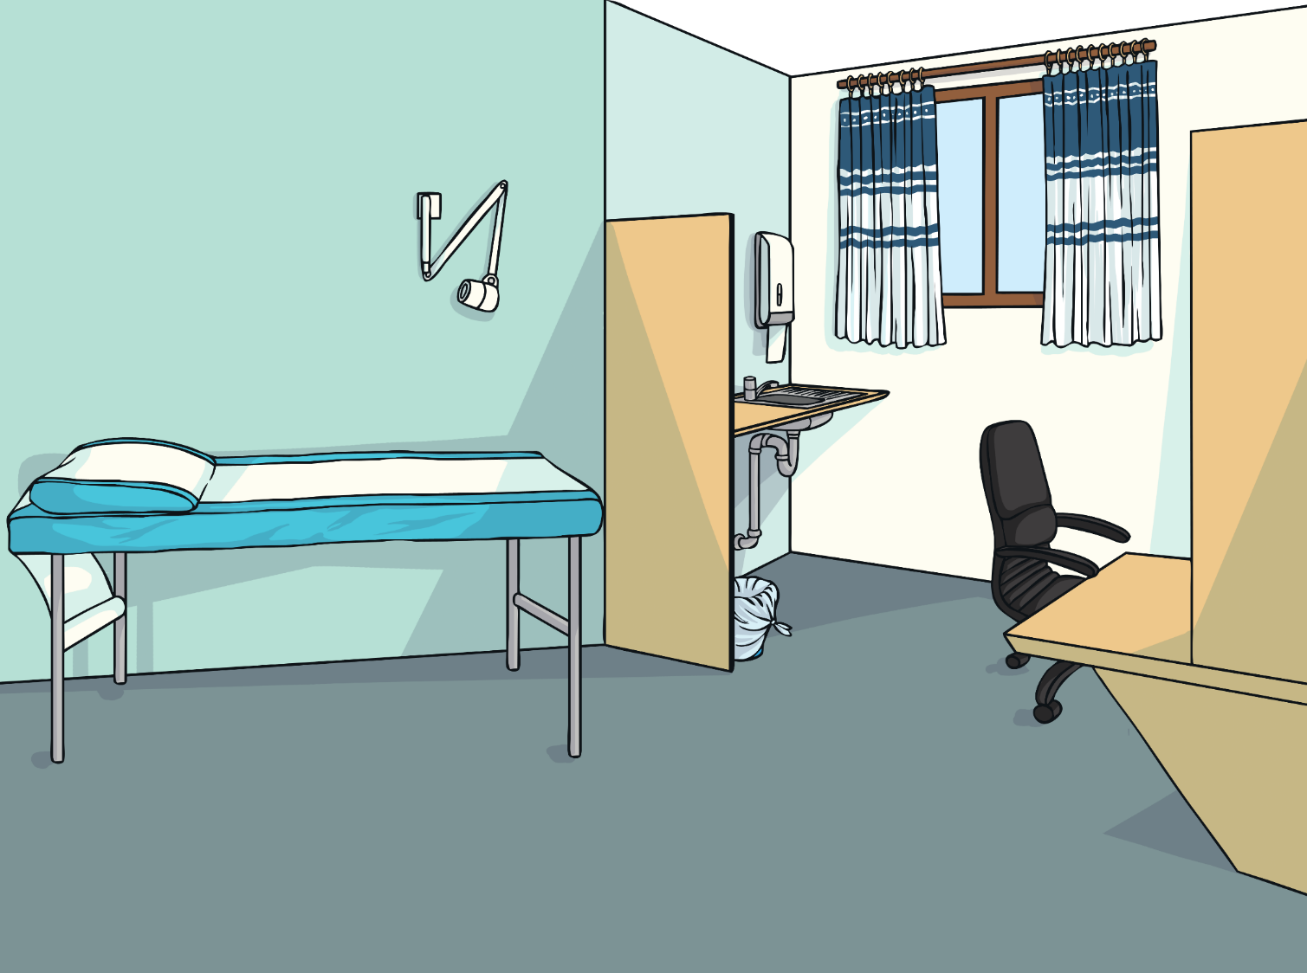
Madame Santé est médecin.
Notes:
Madame Santé is a doctor.

Slide 18
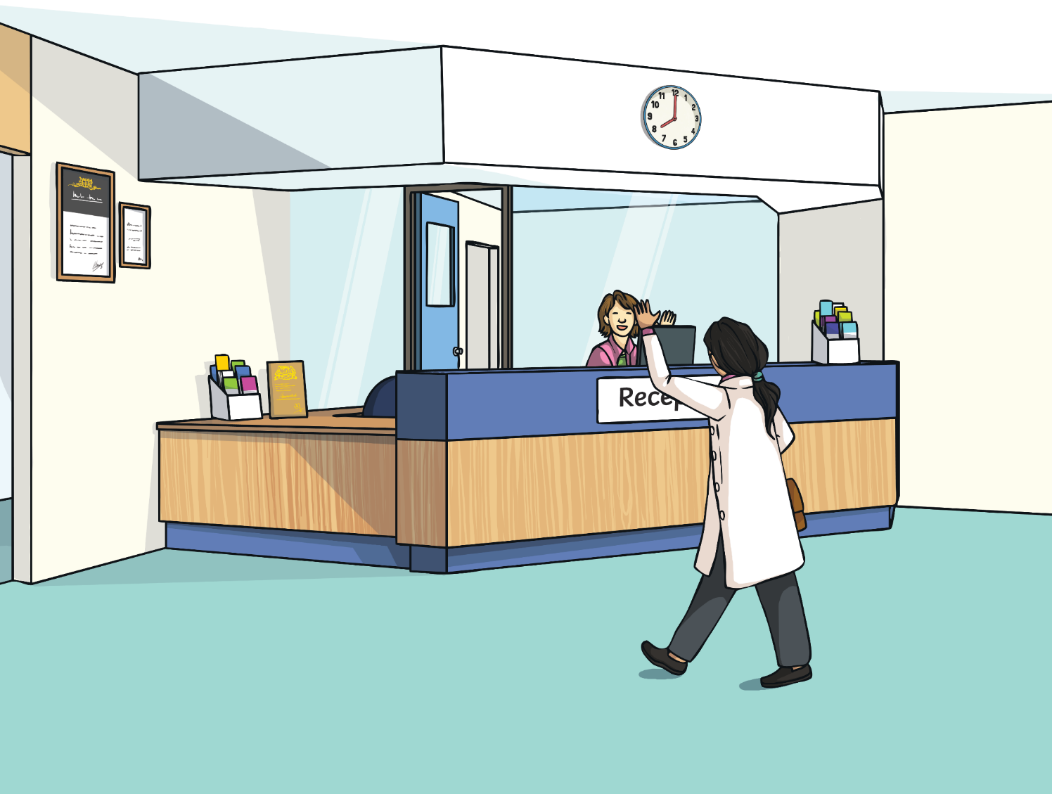
À huit heures, elle arrive au cabinet médical.
Bonjour! Docteur Santé !
Bonjour
é
Notes:
At eight o’clock, she arrives at the surgery.

Slide 19
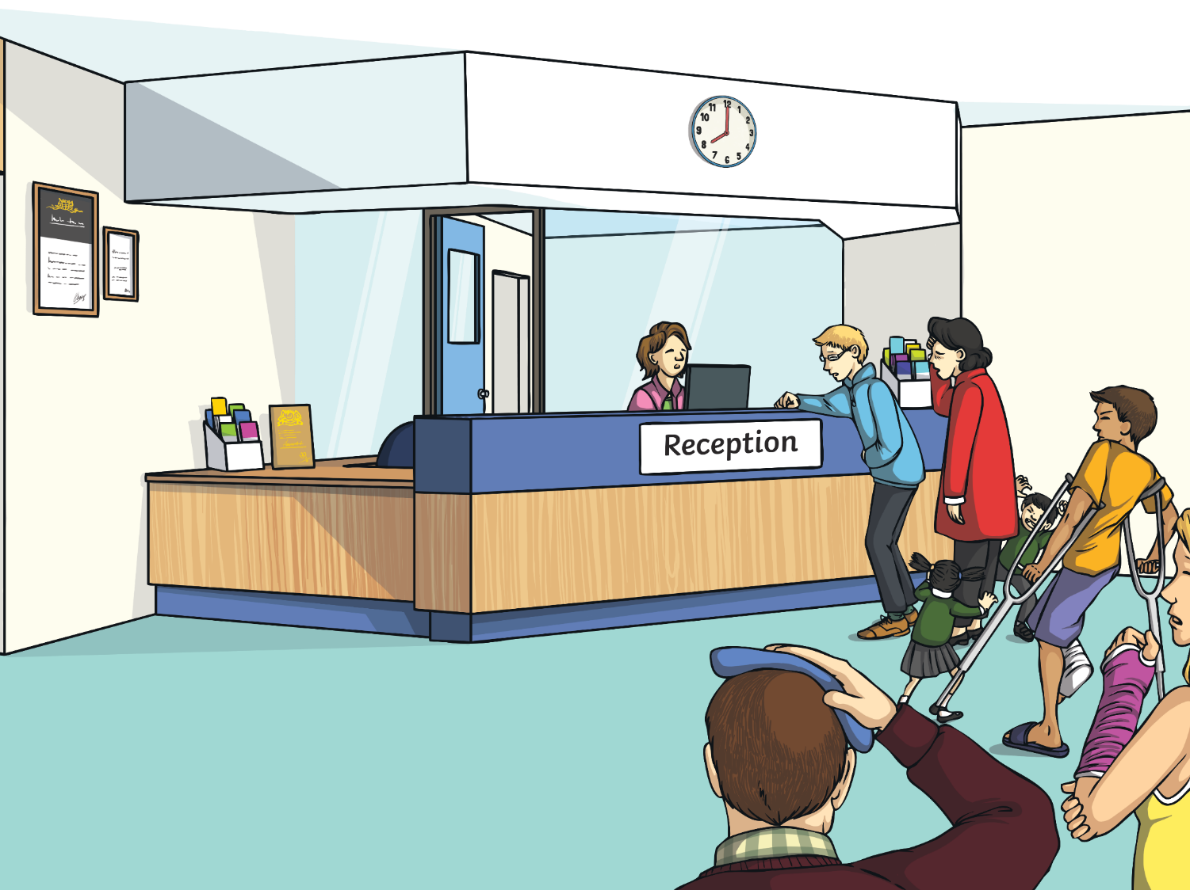
Aujourd’hui, il y a beaucoup de gens malades.
é
Notes:
Today, there are lots of patients waiting.

Slide 20
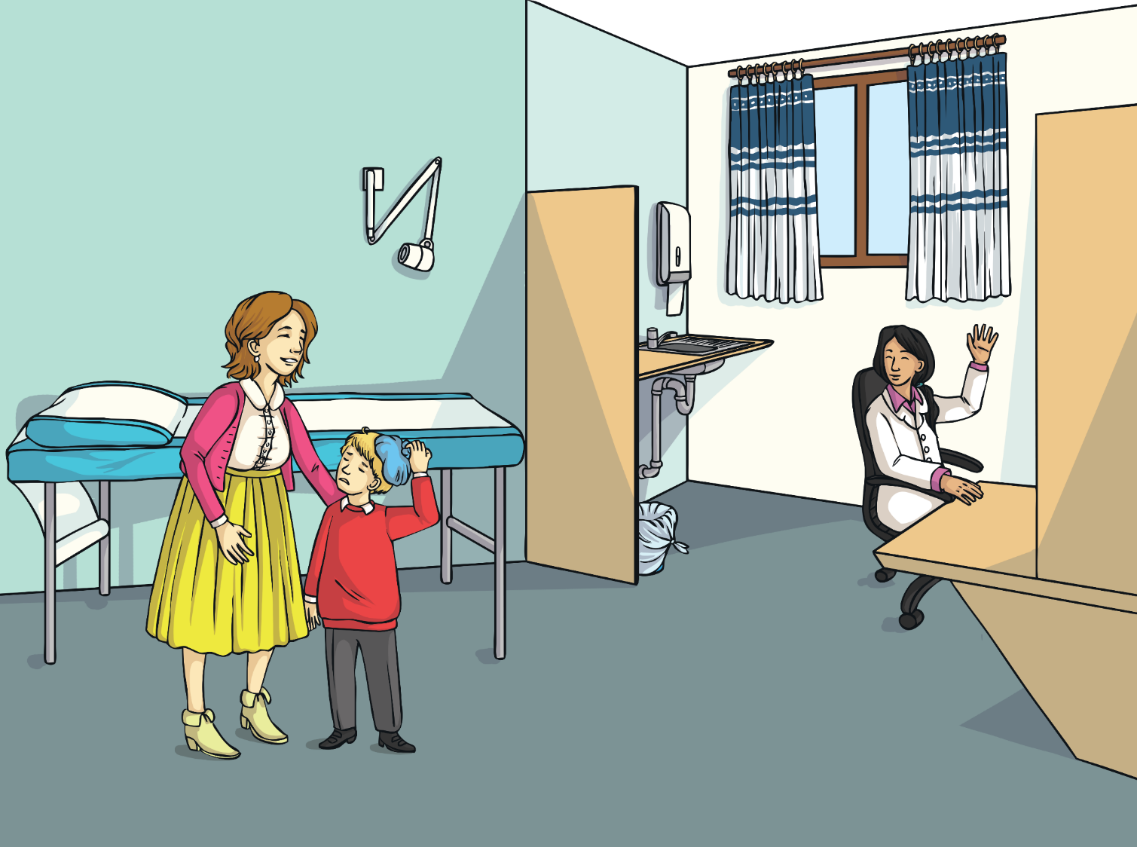
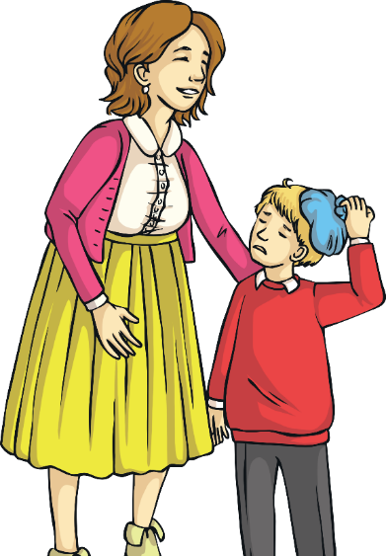
Voici Antoine. Il est malade.
Notes:
This is Antoine. He’s poorly.

Slide 21
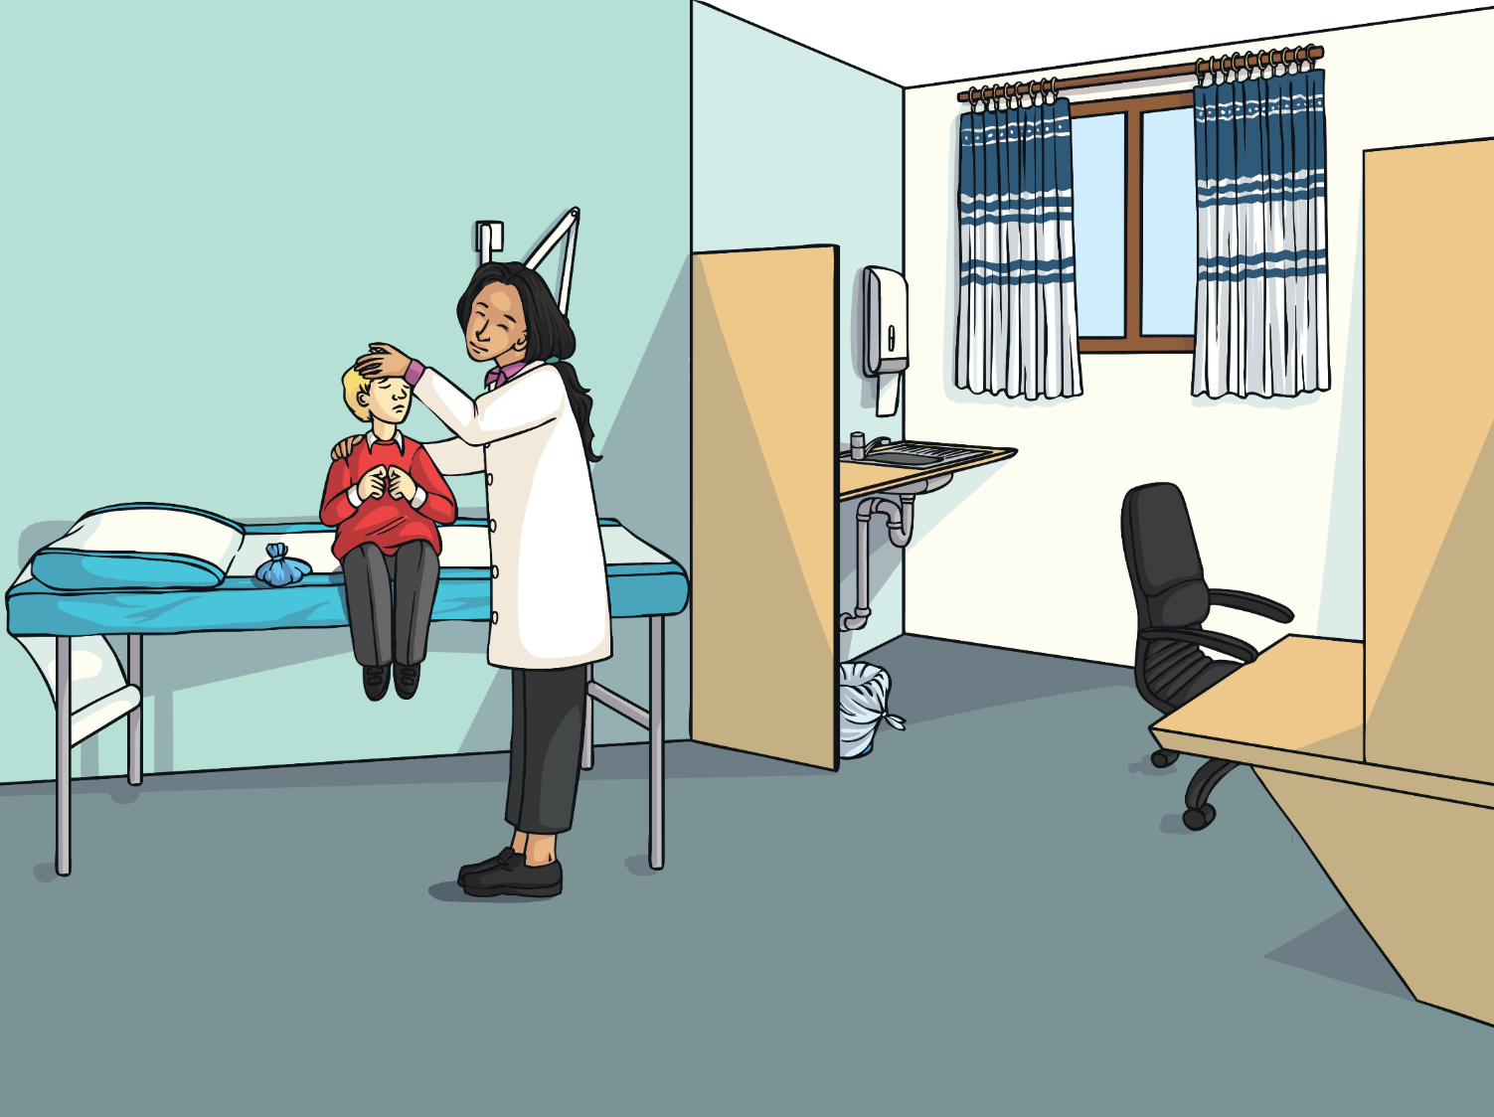
J’ai mal à la tête.
Qu'est-ce qui ne va pas, Antoine ?
Notes:
“What’s the matter Antoine?”
“I’ve got a headache.”

Slide 22
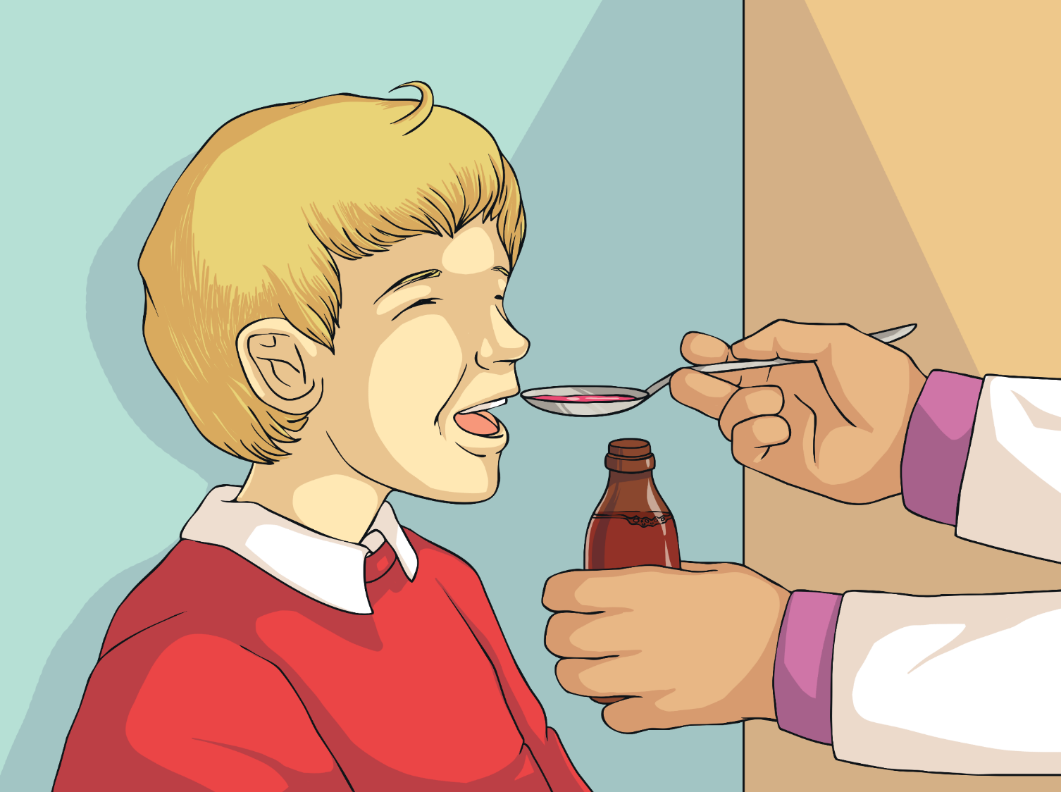
Merci Madame !
Prends ce médicament. Ça ira mieux.
Notes:
“Take this medicine; you will feel better.”
“Thank you Doctor!”

Slide 23
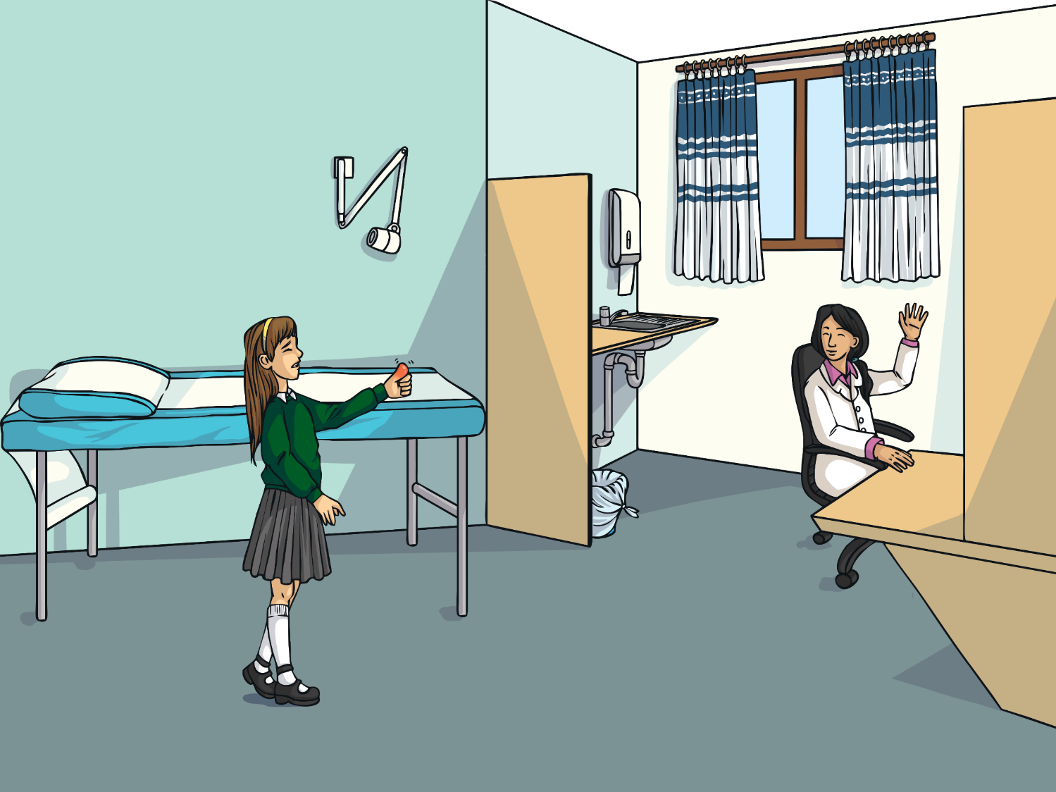
Voici Mélissa. Elle est malade.
Notes:
This is Mélissa. She’s poorly.

Slide 24
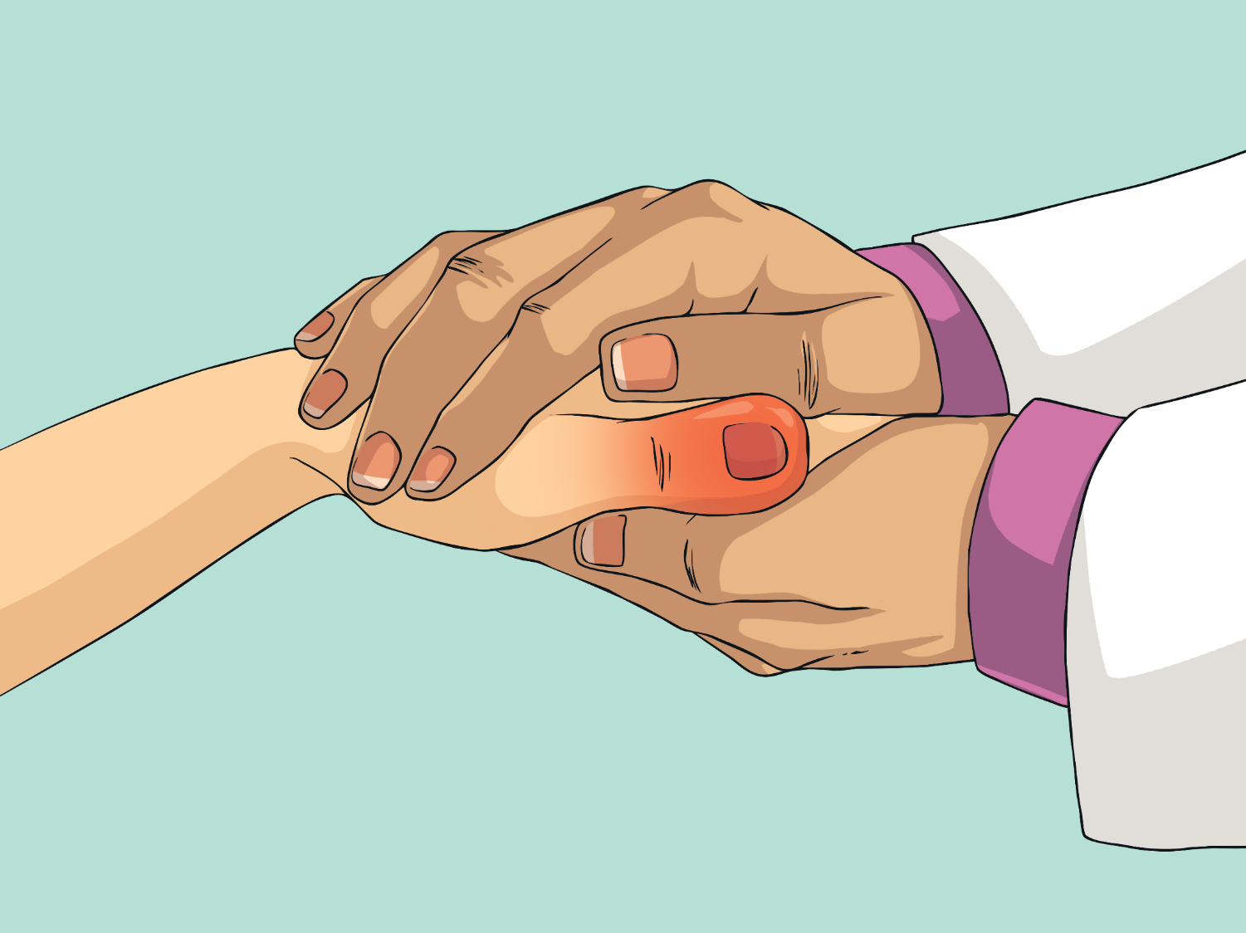
Qu'est-ce qui ne va pas, Mélissa ?
J’ai mal au pouce.
Notes:
“What’s the matter Mélissa?”
“I’ve got a sore thumb.”

Slide 25
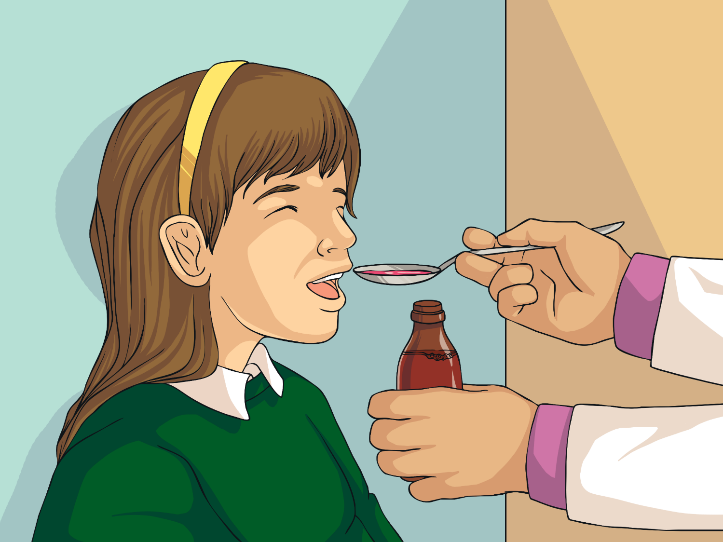
Merci Madame !
Prends ce médicament. Ça ira mieux.
Notes:
“Take this medicine; you will feel better.”
“Thank you Doctor!”

Slide 26
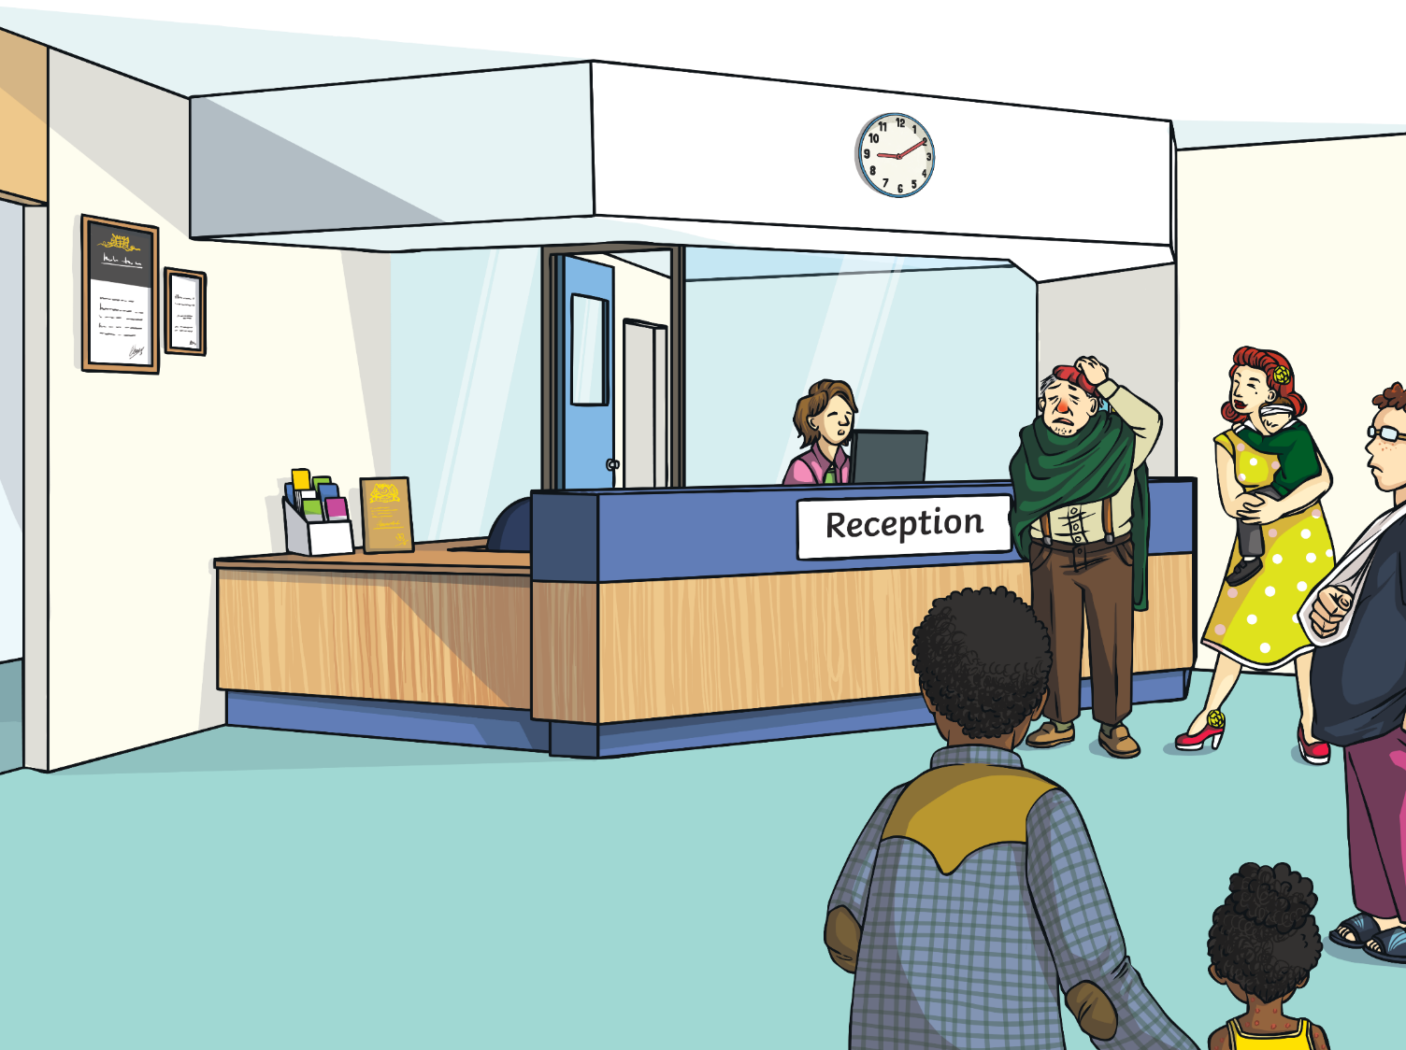
Il y a toujours beaucoup de gens malades.
é
Notes:
There are still lots of patients waiting.

Slide 27
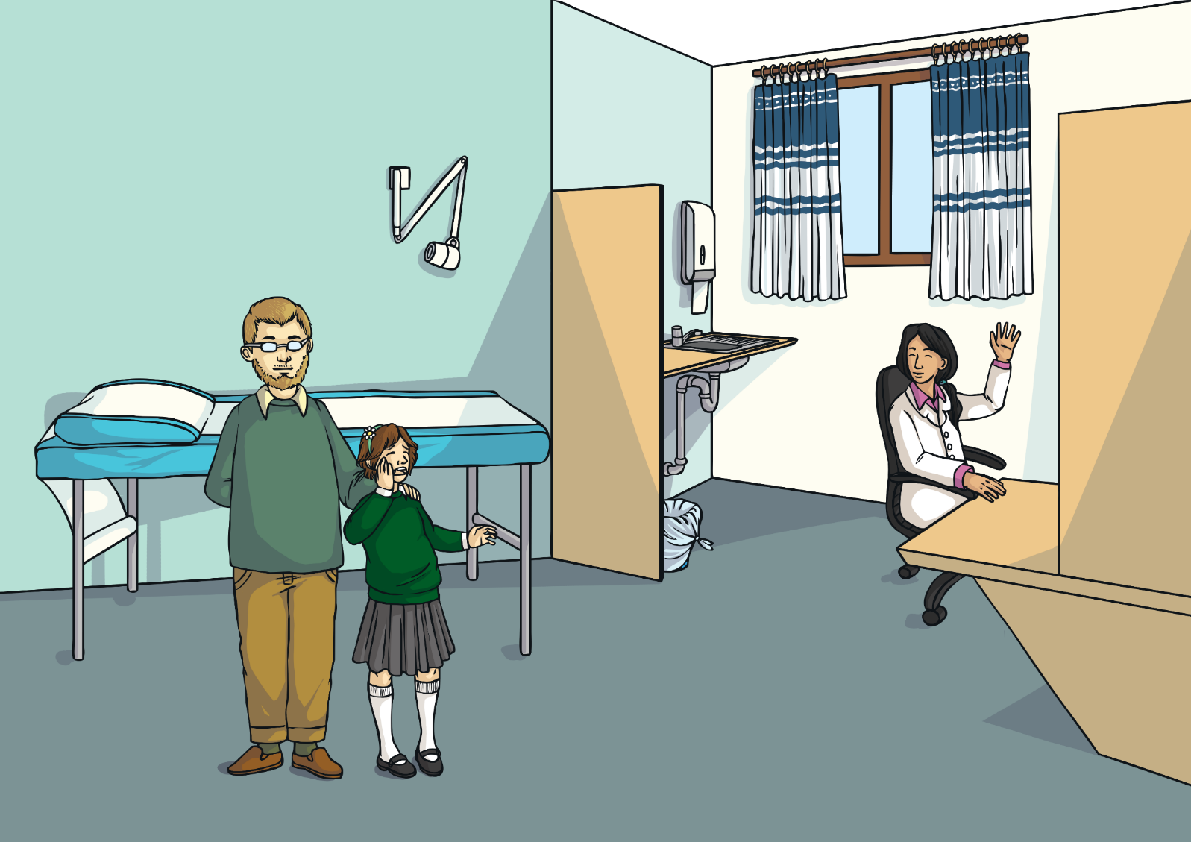
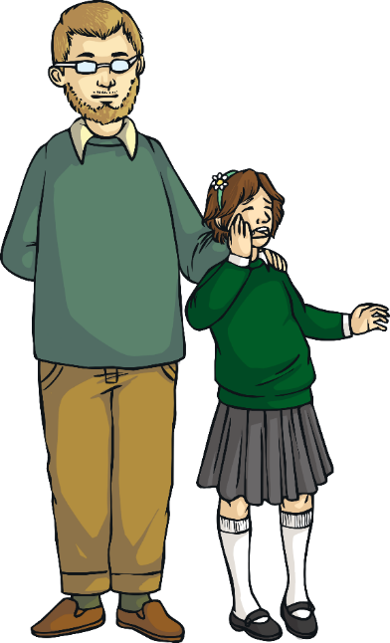
Voici Bernadette-Sophie. Elle est malade.
Notes:
This is Bernadette-Sophie. She’s poorly.

Slide 28
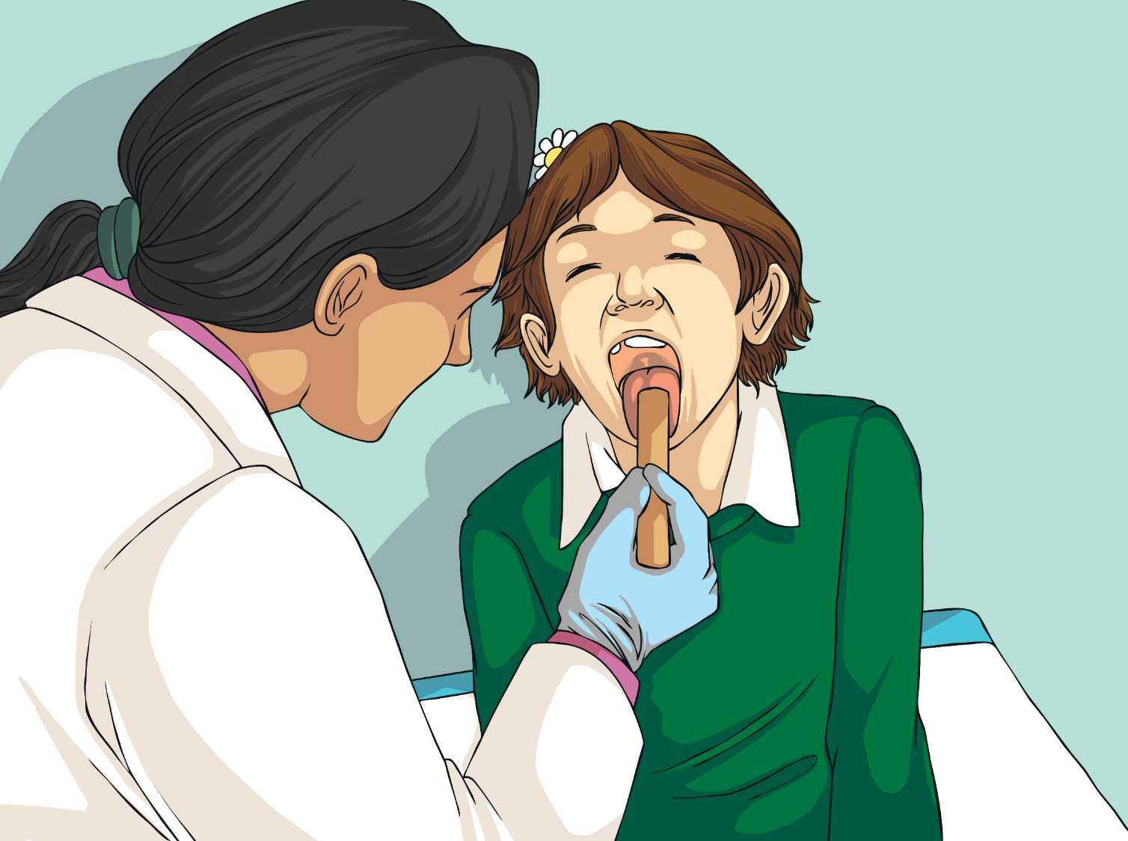
J’ai mal aux dents.
Qu'est-ce qui ne va pas, Bernadette–Sophie ?
Notes:
“What’s the matter Bernadette -Sophie?”
“I’ve got toothache.”

Slide 29
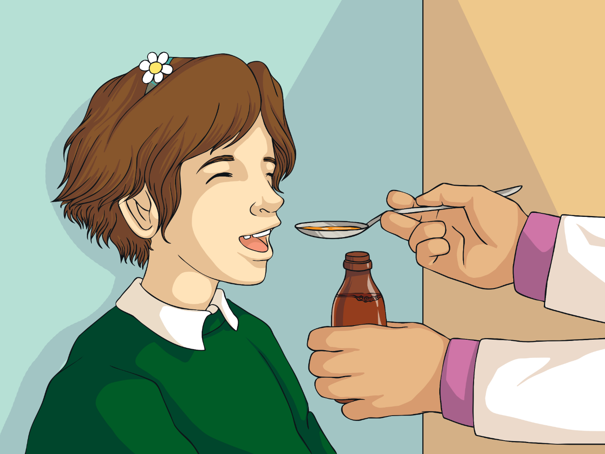
Merci Madame !
Prends ce médicament. Ça ira mieux.
Notes:
“Take this medicine; you will feel better.”
“Thank you Doctor!”

Slide 30
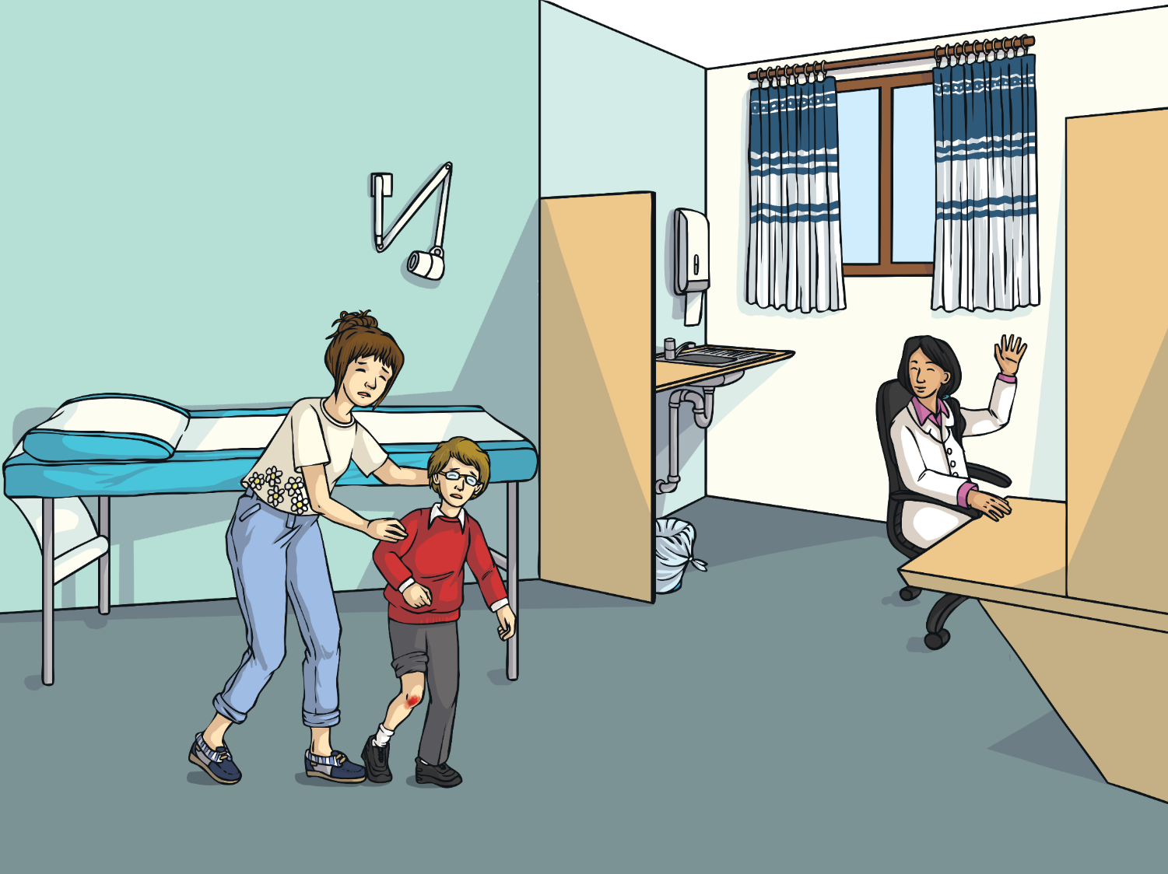
Voici Xavier. Il est malade.
Notes:
At eight o’clock, she arrives at the surgery.

Slide 31
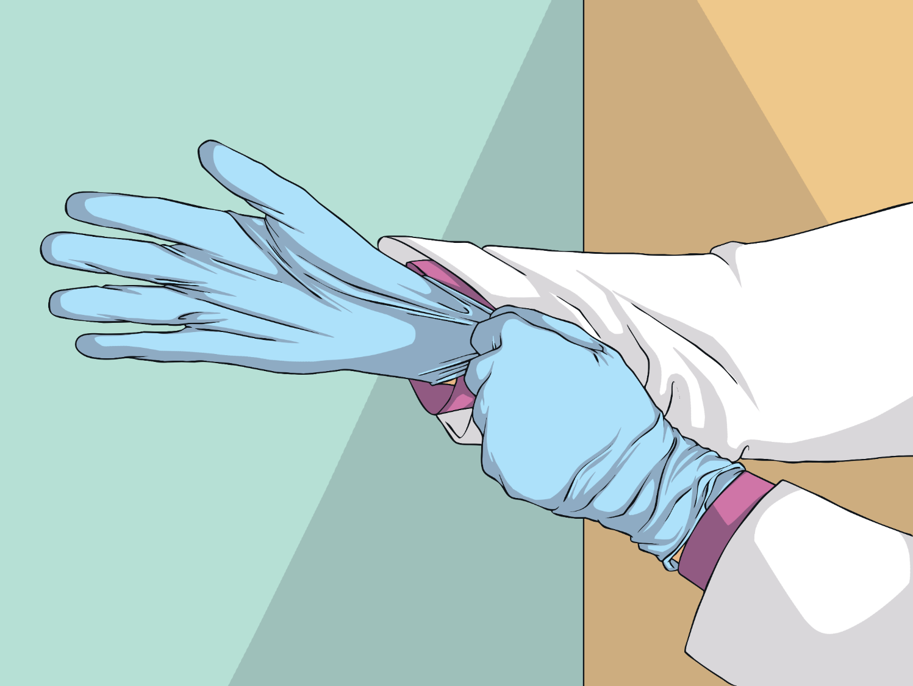
Qu'est-ce qui ne va pas, Xavier ?
J’ai mal au genou.
Notes:
“What’s the matter Xavier?”
“I’ve got a sore knee.”

Slide 32
Voilà. Ça ira mieux.
Merci Madame !
Notes:
“There you are; you’ll feel better.”
“Thank you Doctor!”

Slide 33
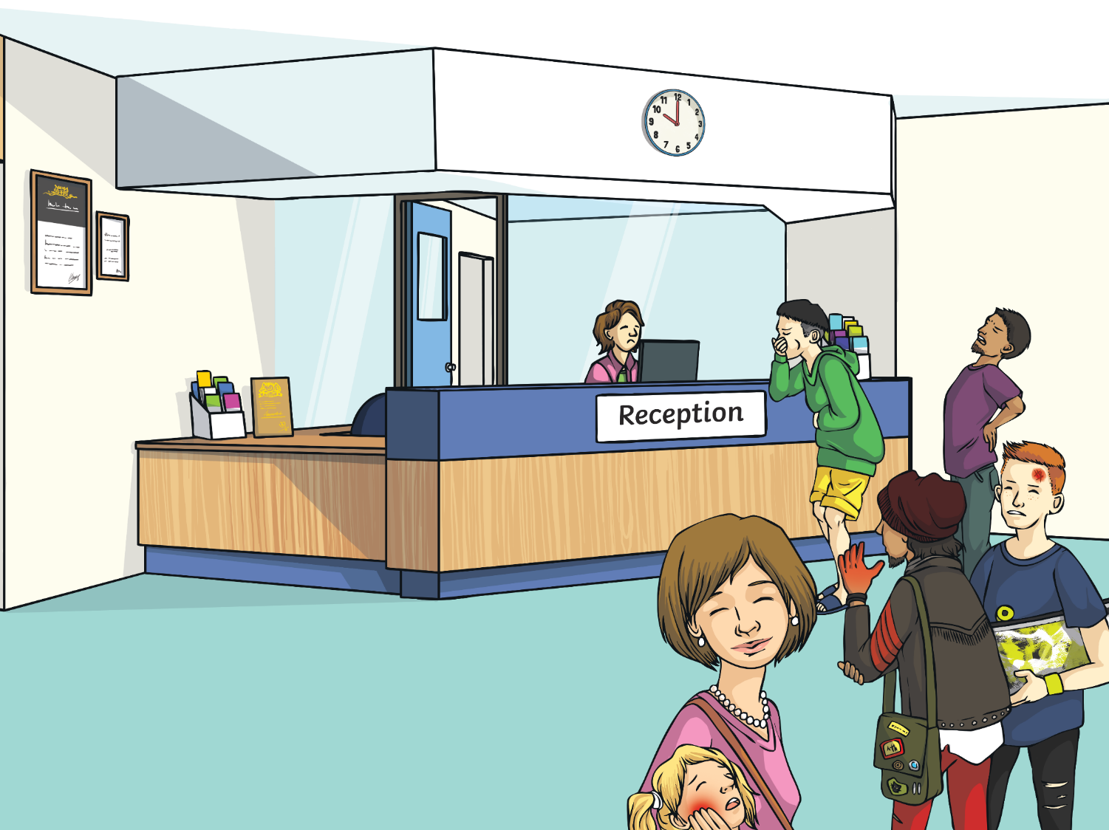
Il y a toujours beaucoup de gens malades.
é
Notes:
There are still lots of patients waiting.

Slide 34
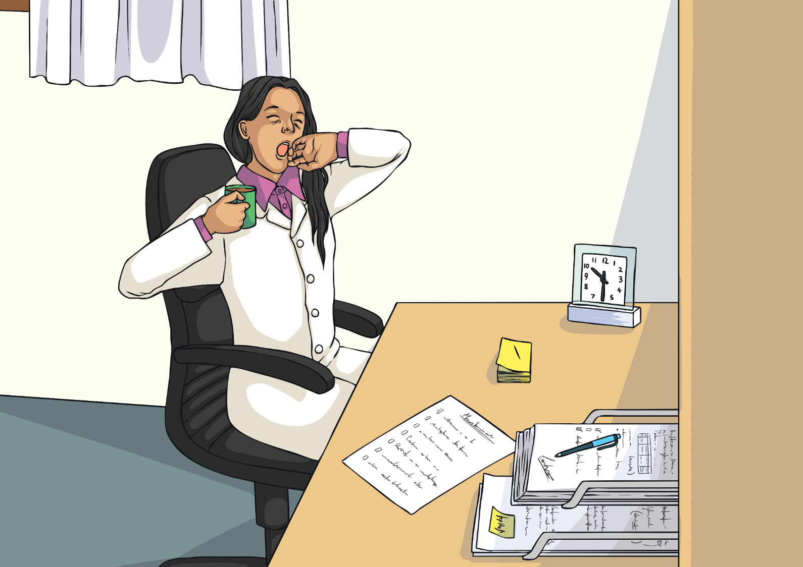
À dix heures et demie, Docteur Santé boit un grand café…
…mais elle est toujours fatiguée.
Notes:
At ten-thirty am, Doctor Santé has a large cup of coffee, but she is still tired.

Slide 35
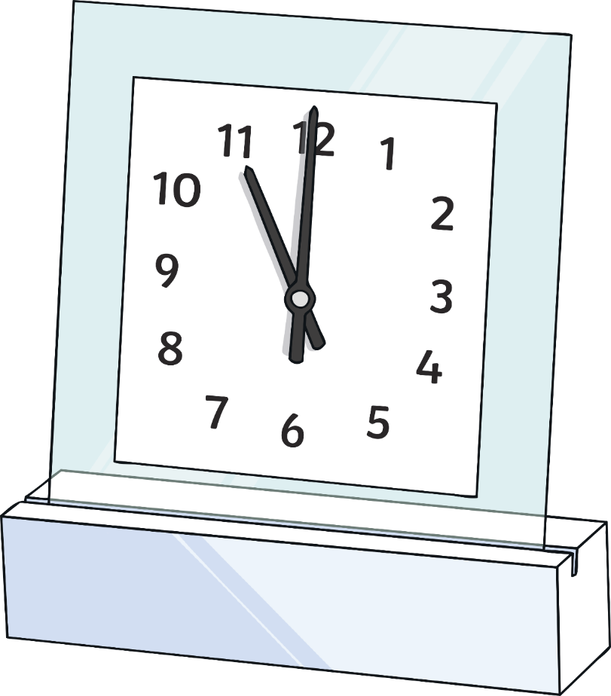
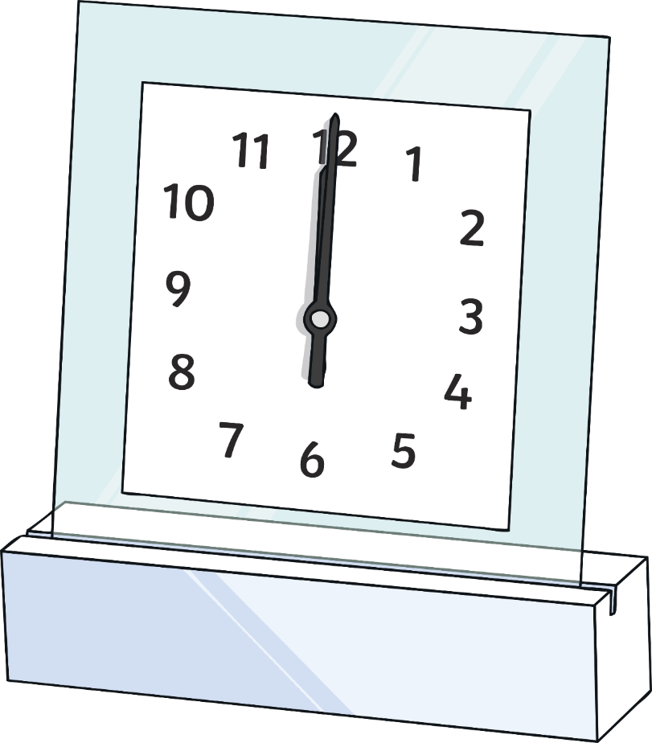
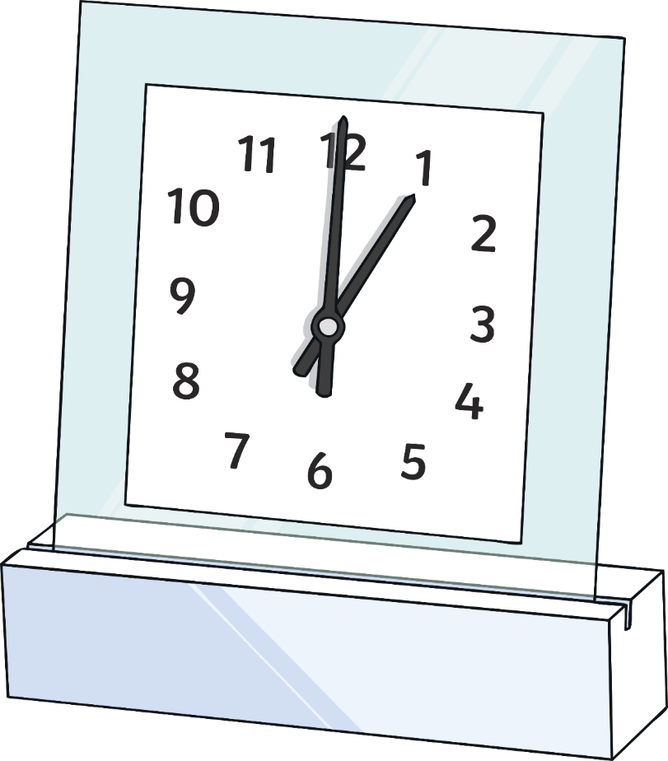
La journée continue…
Notes:
The day goes on…

Slide 36
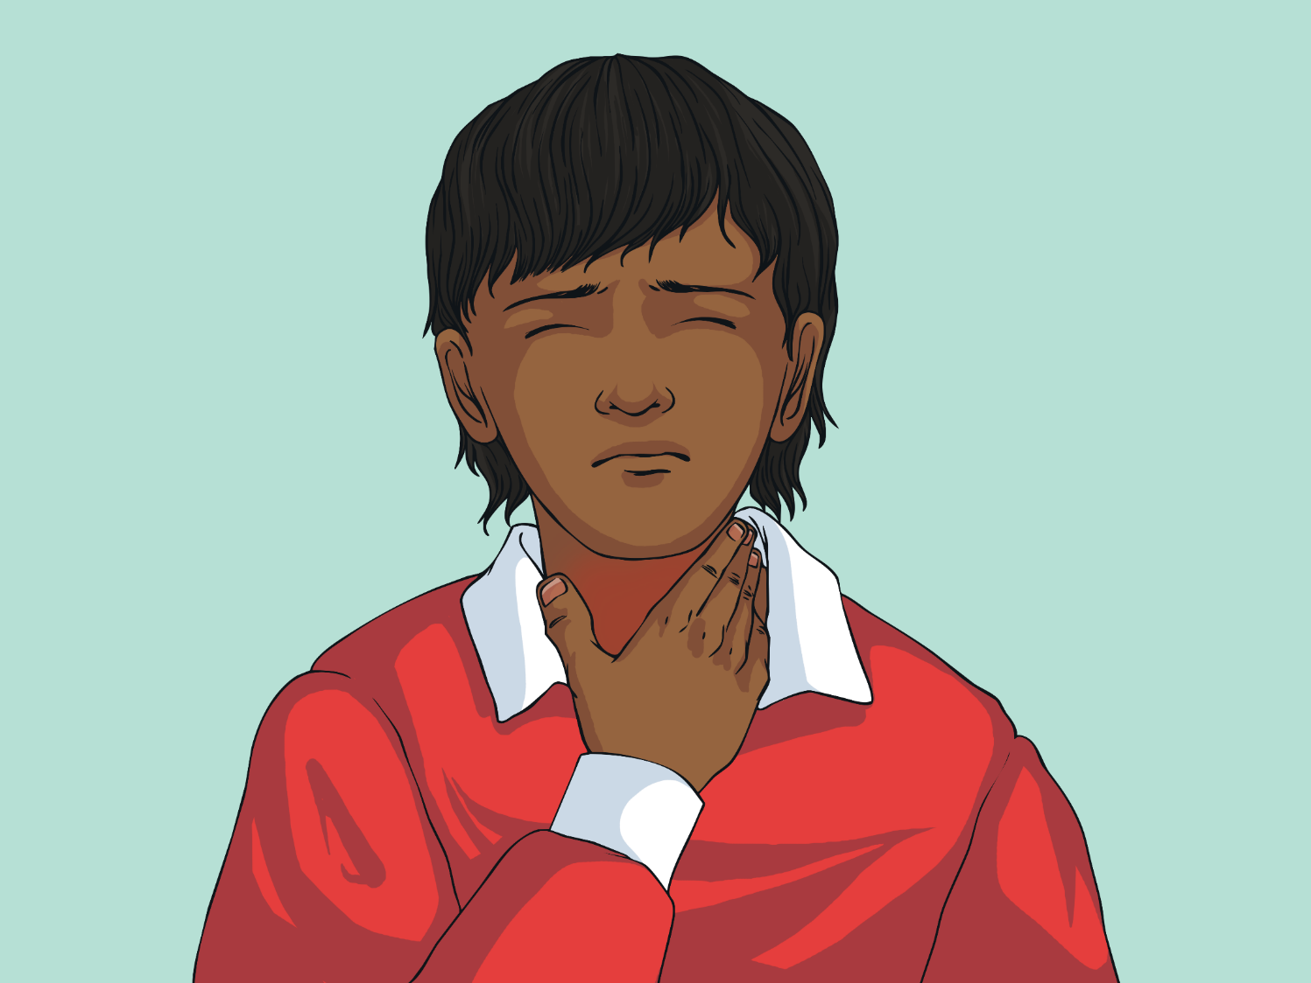
Je m’appelle Marius. J’ai mal à la gorge.
Notes:
“My name is Mariusz. I’ve got a sore throat.”

Slide 37
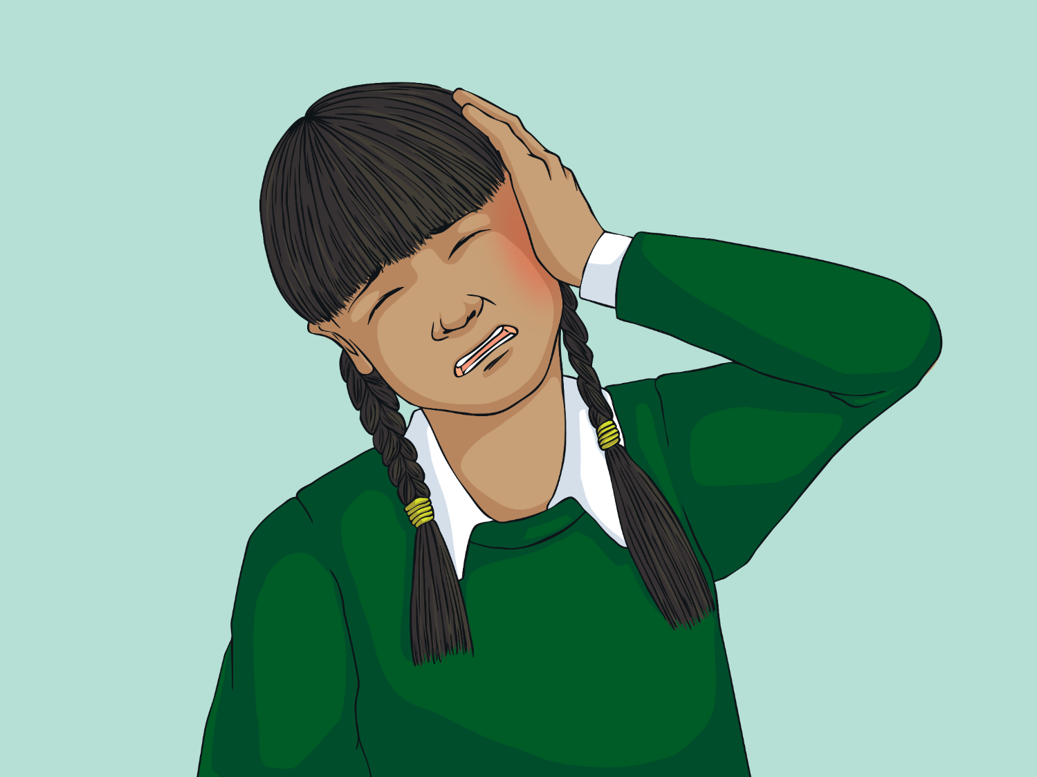
Je m’appelle Zizu. J’ai mal à l’oreille.
Notes:
“My name is Zizu. I’ve got ear ache.”

Slide 38
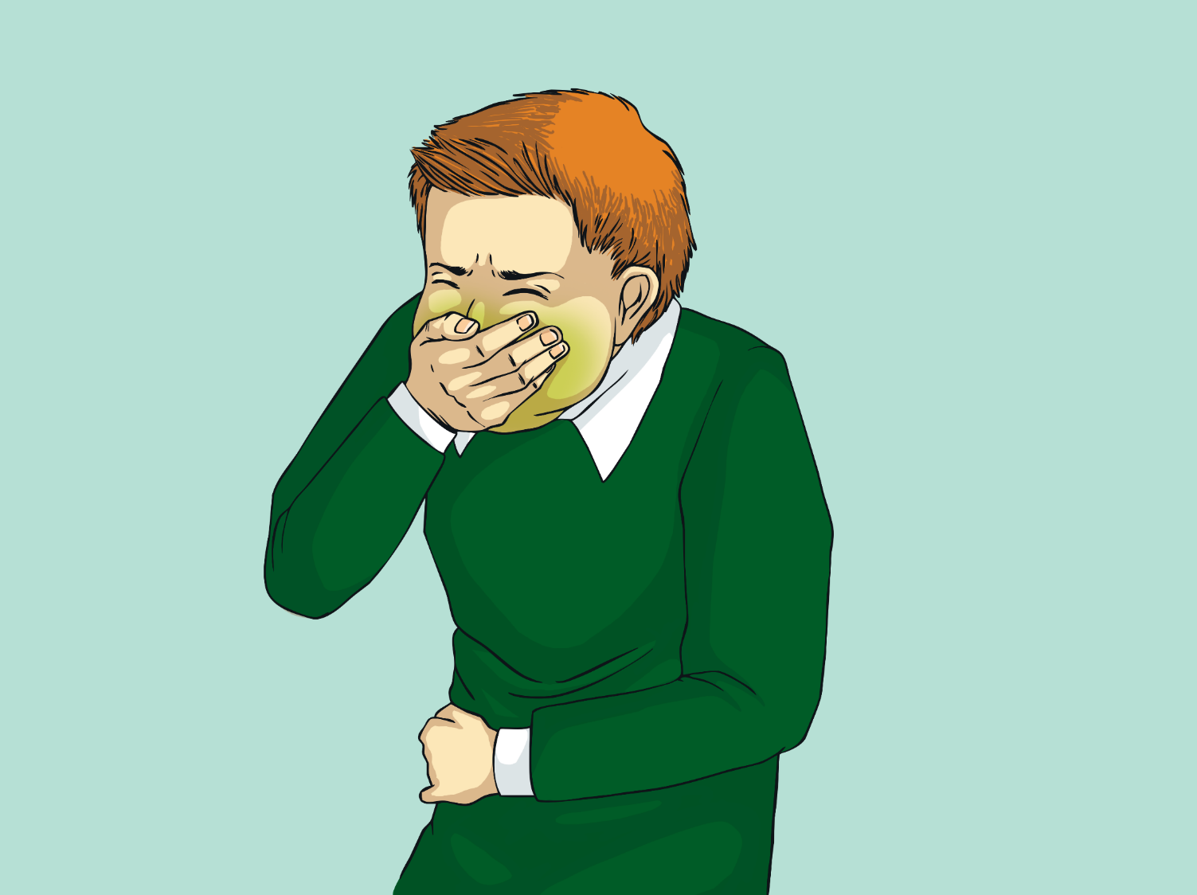
Je m’appelle Pilou. J’ai mal au coeur.
Notes:
“My name is Pilou. I feel sick.”

Slide 39
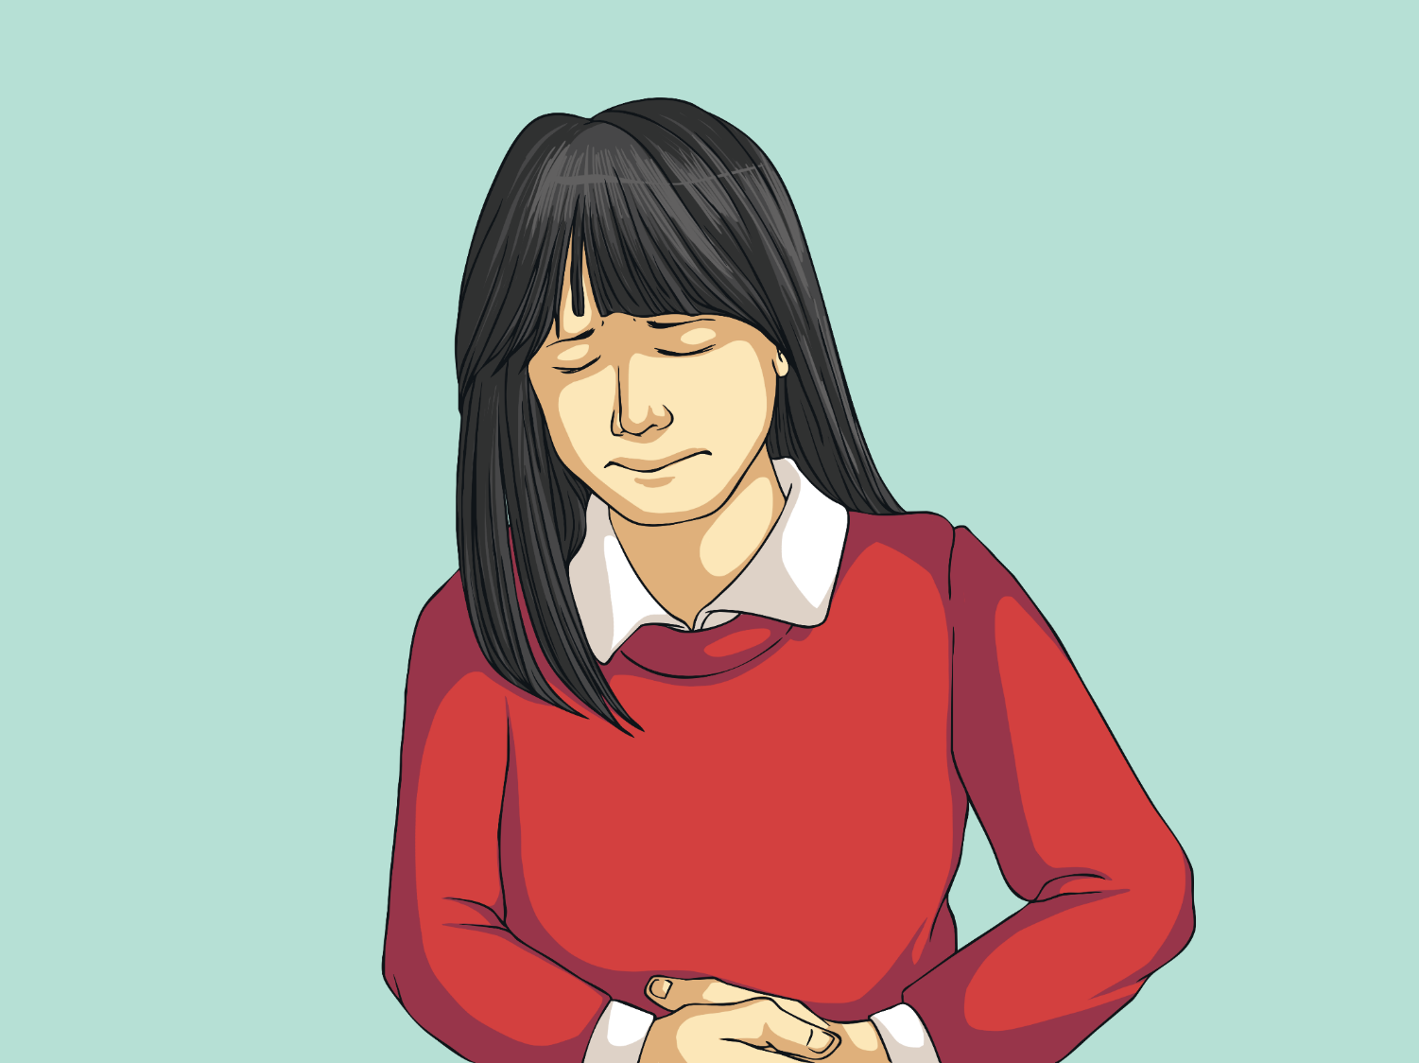
Je m’appelle Joséphine. J’ai mal au ventre.
Notes:
“My name is Joséphine. I’ve got tummy ache.”

Slide 40
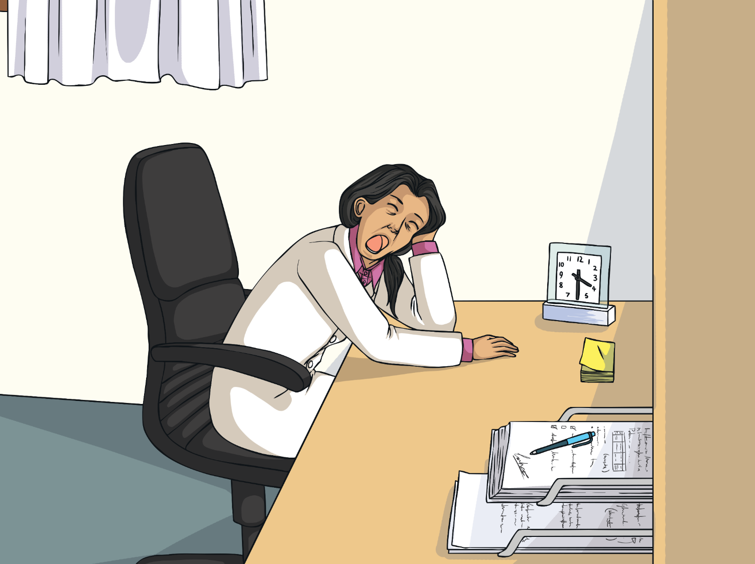
Pauvre Docteur Santé ! Elle veut dormir.
Notes:
Poor Dr Santé! She wants to go to sleep.

Slide 41
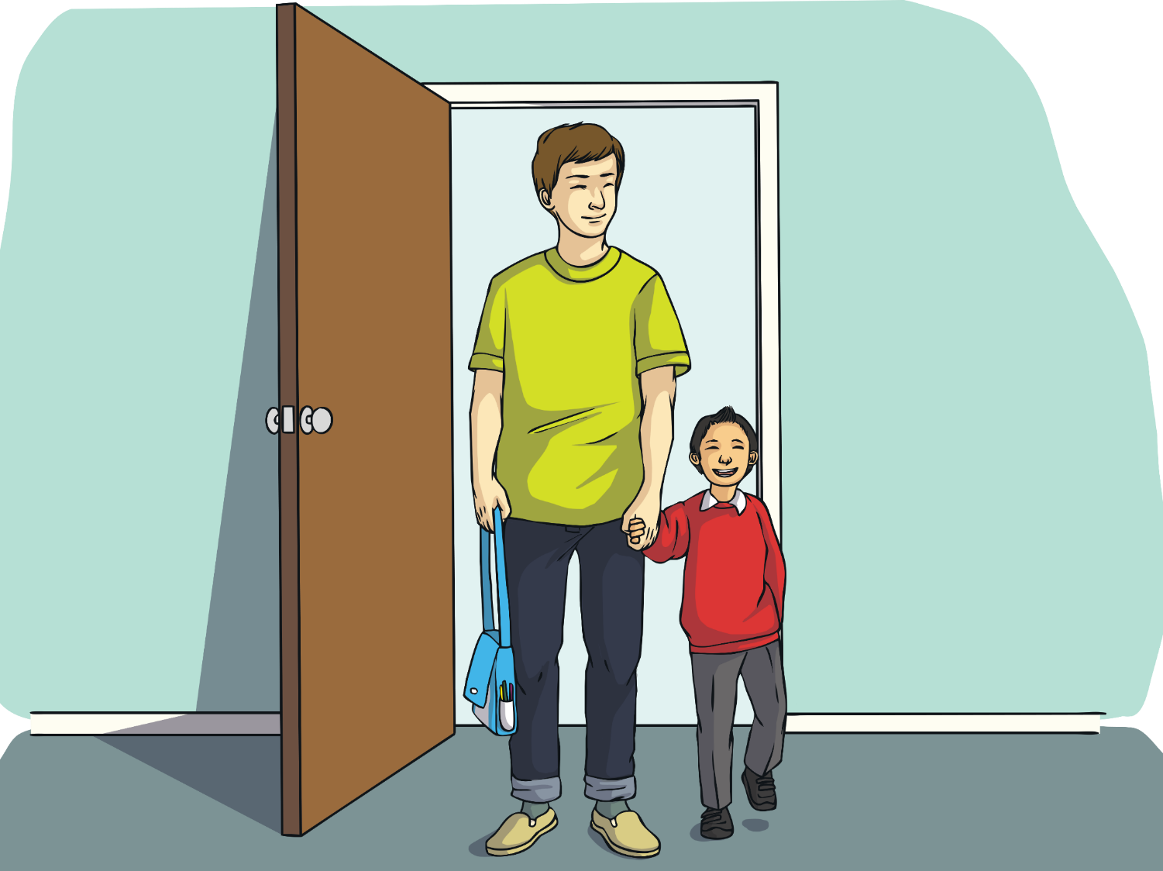
Finalement, les derniers gens arrivent.
Notes:
Finally, here come the last people.

Slide 42
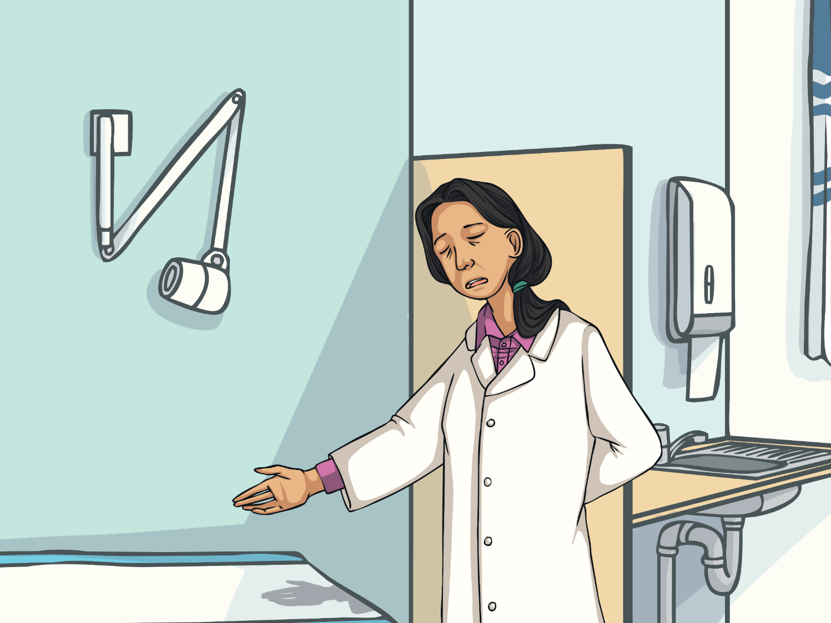
Bonjour, assieds-toi. Et qu'est-ce qui ne va pas ?
Notes:
“Hello, sit down. And what’s the matter with you?”

Slide 43
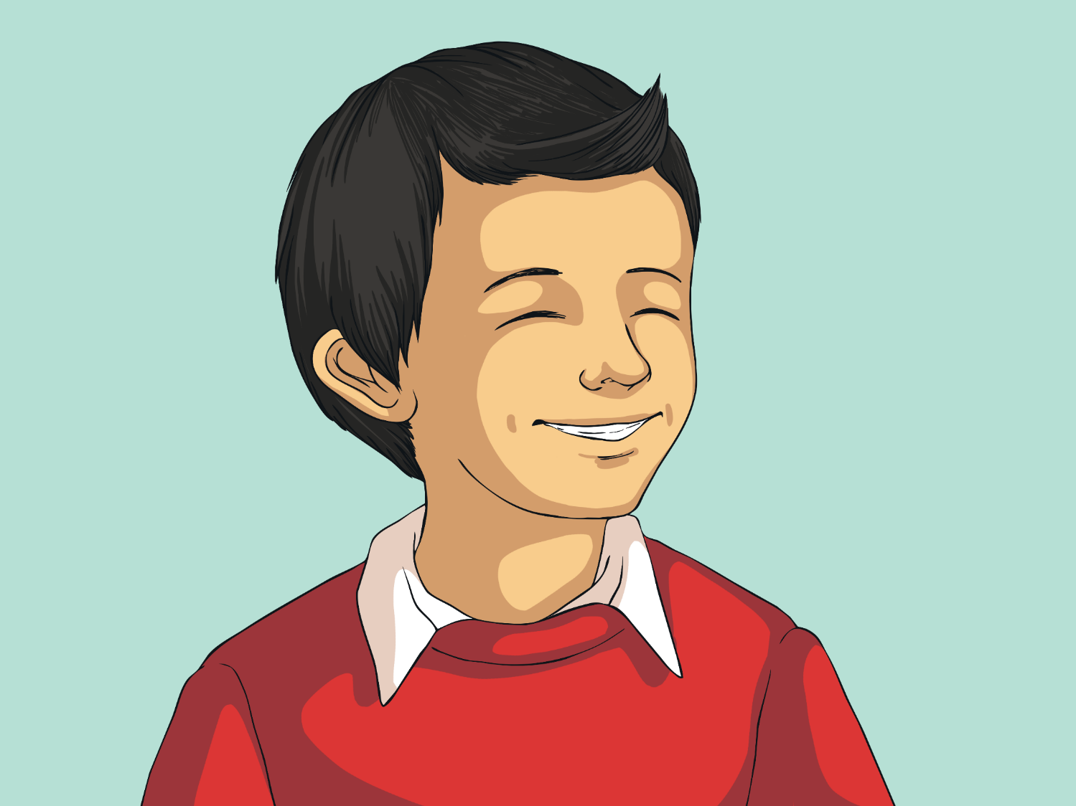
Rien. Je ne suis pas malade.
Notes:
“Nothing. I’m not sick.”

Slide 44
Mais, si tu n’es pas malade, pourquoi es-tu ici ?
Notes:
“But, if you’re not sick, why are you here?”

Slide 45
C’est moi, maman : Nicolas. Papa et moi sommes ici pour te ramener à la maison !
Notes:
“It’s me mummy: Nicholas. Daddy and I have come to take you home!”

Slide 46
Génial ! Je suis très
fatiguée ; allons-y !
Notes:
“Brilliant! I’m really tired; let’s go!”

Slide 47
Tu as passé une bonne journée maman ?...Maman ?
Notes:
Have you had a good day mummy?...Mummy?”

