Slide 2
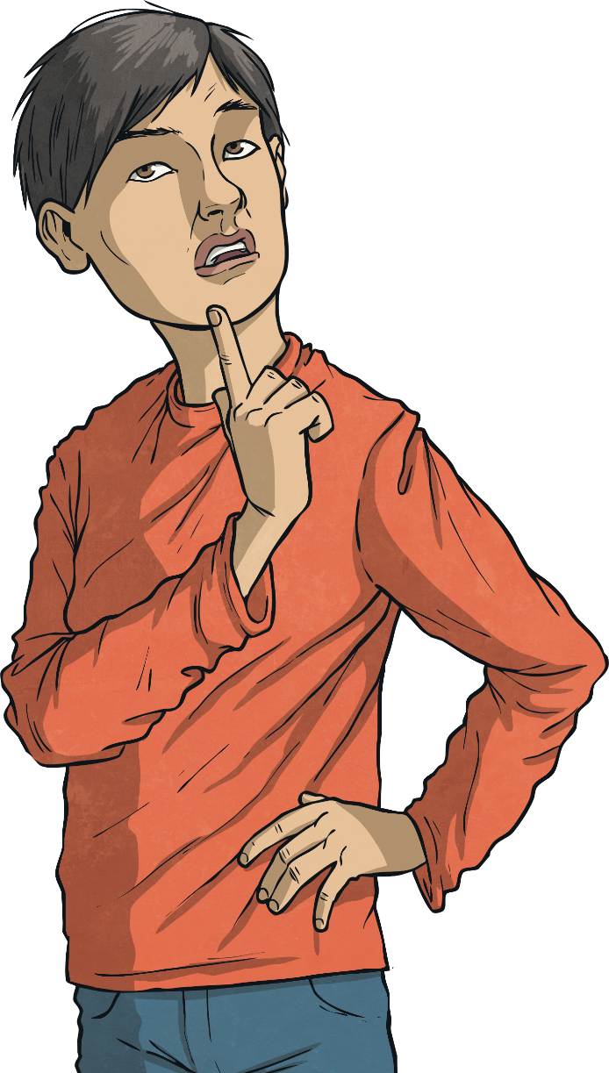
The Job’s Yours!
You have been appointed the new chief rollercoaster
designer for a top UK theme park.
Your first assignment is to design a
rollercoaster to be built next year.
As with all professional designers doing jobs like this, you will need to create a scale model (not full size!) which can be tested in your home – by a marble, not you unfortunately! If you don’t have a marble then you could use scrunched up tinfoil, a golf ball or playdough or anything that is small and will roll well.

Slide 3
Design Features
When it’s done, your run will be tested with a marble so you need to think about that in your design.
Also, there are some specifications that the owners of the theme park have asked for so your design needs to include the four following features:
There should be at least one 360° loop.
The whole track must be 2m or longer.
There must be one part of the rollercoaster that is a 45º drop.
At least one part of the rollercoaster must be 1.5m or higher from the ground/surface.

Slide 4
The Materials
Your rollercoaster doesn’t all have to be made from the same materials but all materials used have to be big enough for a marble to test it.
To get you thinking, think about the advantages of each of these materials. You might also have your own ideas or materials to use.
Click on the boxes to reveal the contents.
Material | Plastic | Folded v-shaped carboard | Cardboard tubes | What other materials could you use? Old pipes or tubing maybe
Explanation | Can be flexible, some are transparent | A v-shaped design made from flat card | Insides of kitchen roll and other items
Advantages | It’s flexible, the contents can’t drop off and you can see through to the inside. | It has a covered top so the marble doesn’t fall out, it is flexible for gentle curves and can be sawn in half for an open-top run. | These are cheap and easily available and stiff for straight runs. | These are easy and cheap to use and can be stiff for straight runs.
Disadvantages | It is not rigid so would need support. | It is not flexible and could be too big. | It would have to be cut to go around corners. | It can’t go around corners or support itself as the v-shape would fall over.

Slide 5
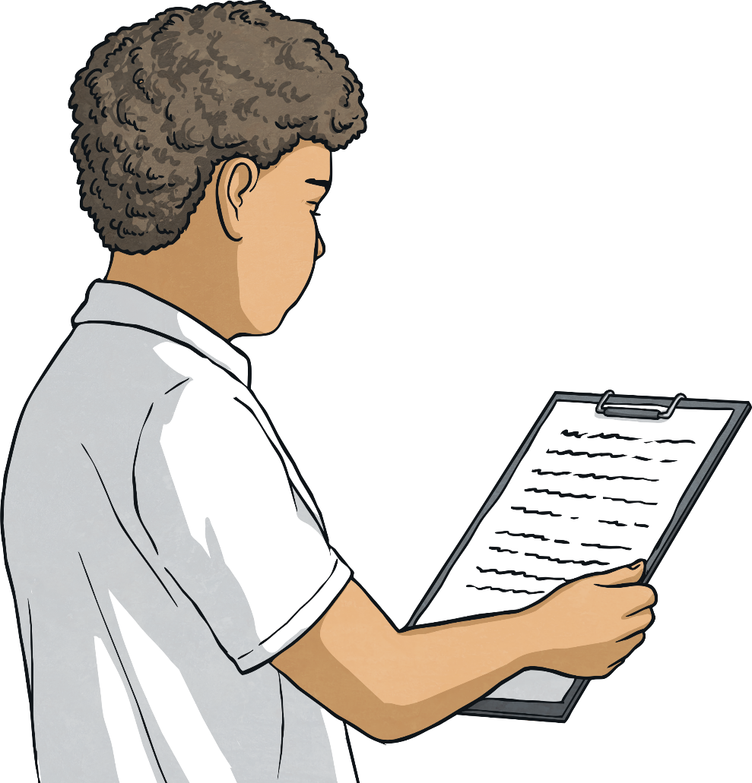
Tests
Before putting pencil to paper with your design, you need to gather some materials and a marble to start testing what works and what doesn’t.
Carry out some tests in your group and make notes on the outcomes before sharing them with your teacher and class.
Think about:
the speed needed to make a marble go around the loop;
how to stop the marble from falling out of the run;
how to keep parts of the run stable so it won’t fall over.

Slide 6
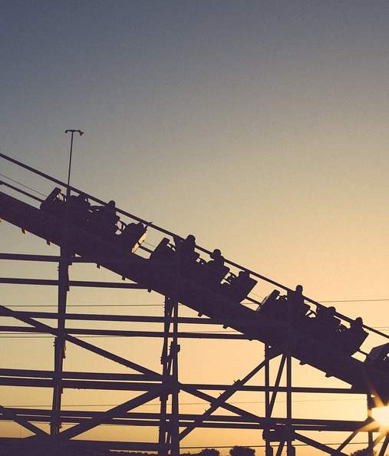
Design Time
Use the design sheets to work on your design.
Remember the four features you need to include and what you have learnt from your tests.
The four features:
There should be at least one 360° loop.
The whole track must be 2m or longer.
There must be one part of the rollercoaster that is a 45º drop.
At least one part of the rollercoaster must be 1.5m or higher from the ground/surface.

Slide 7
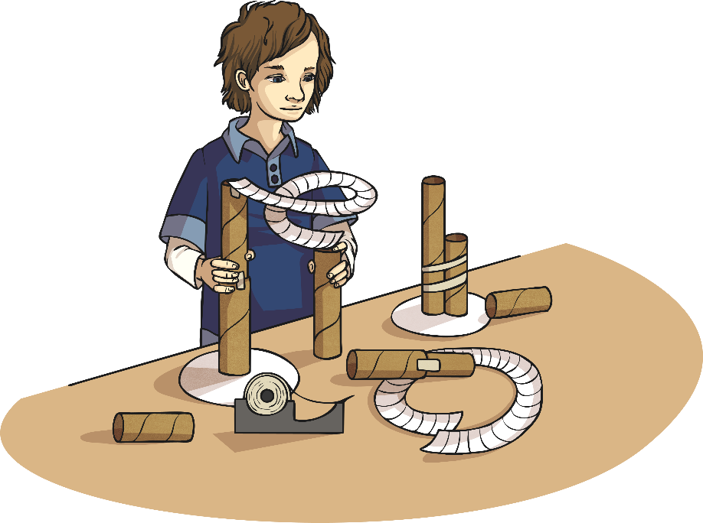
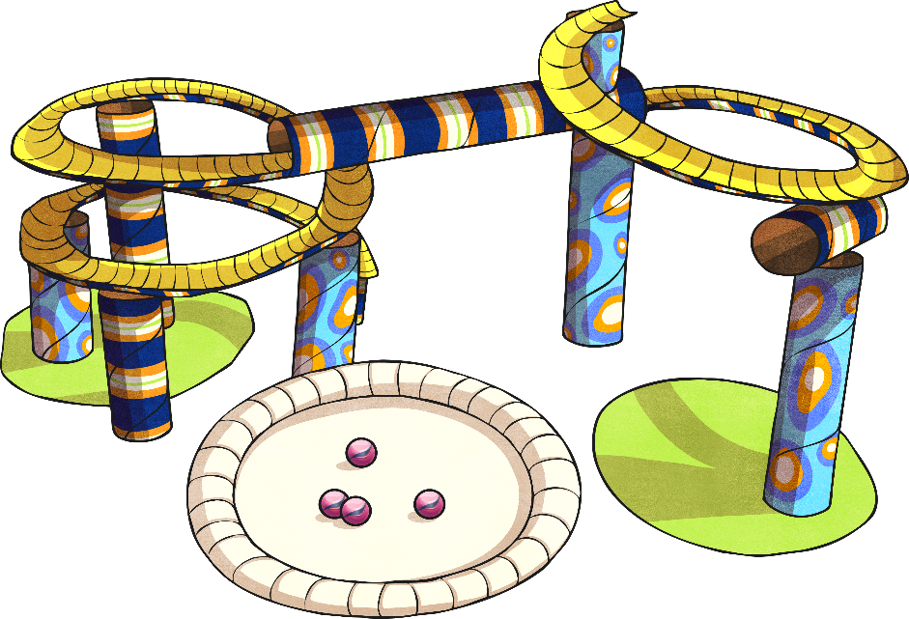
Construction Time
Use design sheets to create your design for real!
Remember, if something isn’t working, make a change to improve it – don’t be scared of adaptations. Keep testing as you go to make sure each part works.

Slide 8
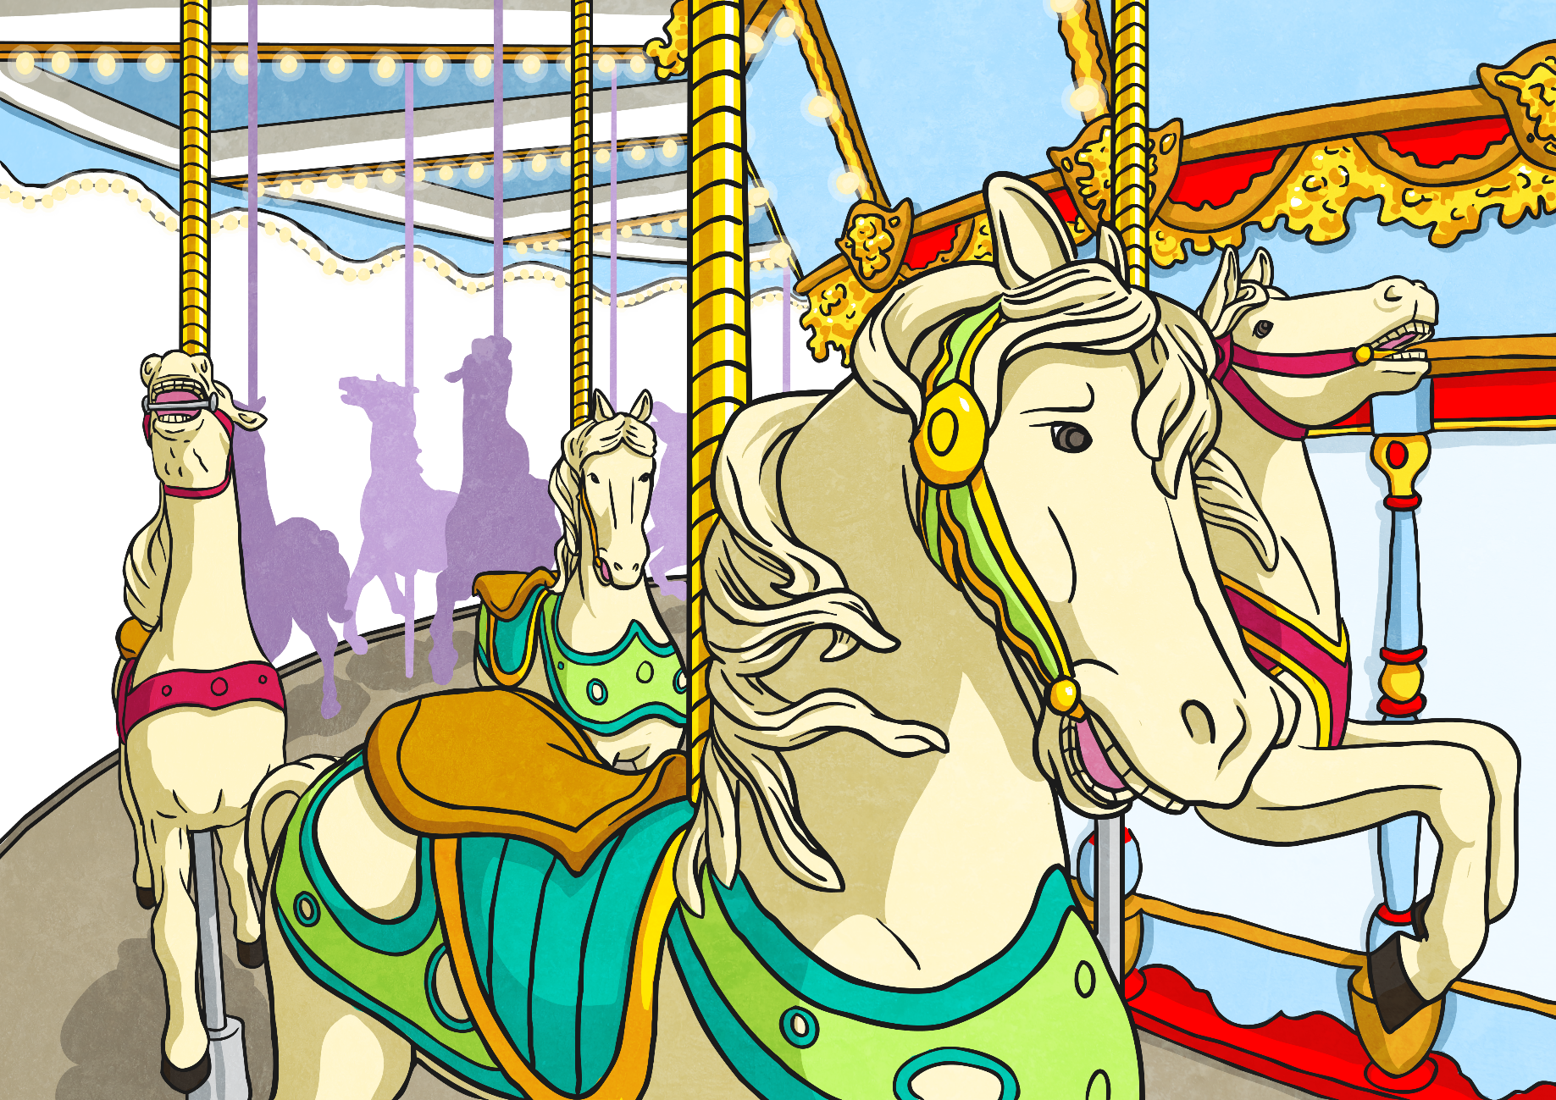
The Big Reveal!
It’s time to test your finished design… will it work?
Each design will be tested with a marble and checked-off against the four requirements.
How will your design fare in the tests?

Slide 9
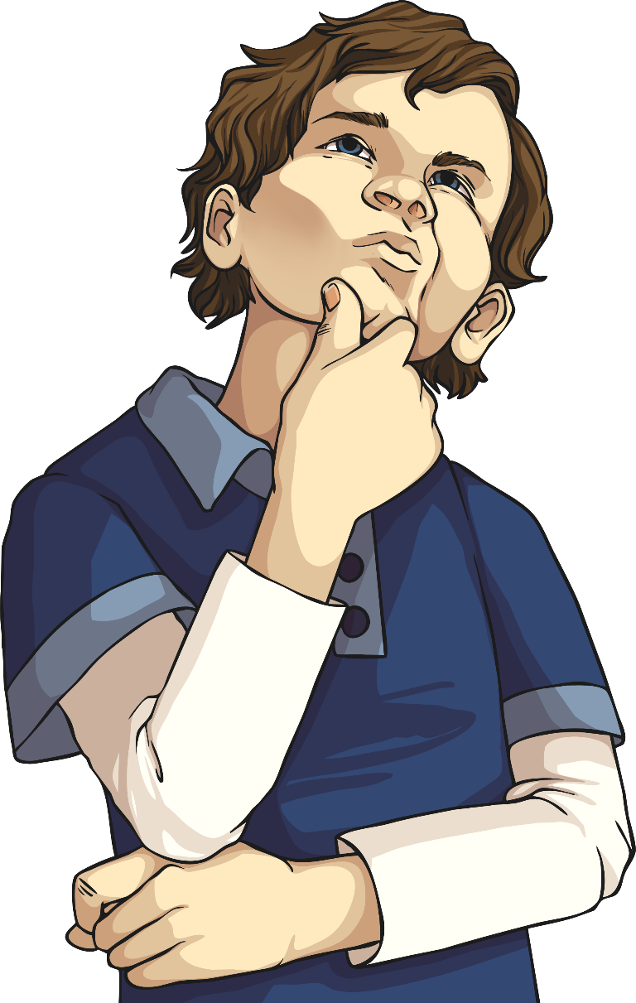
Evaluation Time
Is it back the drawing board, some little design tweaks or on to rollercoaster glory?
Use the evaluation sheets to take some time to think
about how your design fared in the tests and how
well it fitted the design brief.
If you had the task again, what would you
do differently?
Has it made you want to be a rollercoaster
designer?

