Slide 1
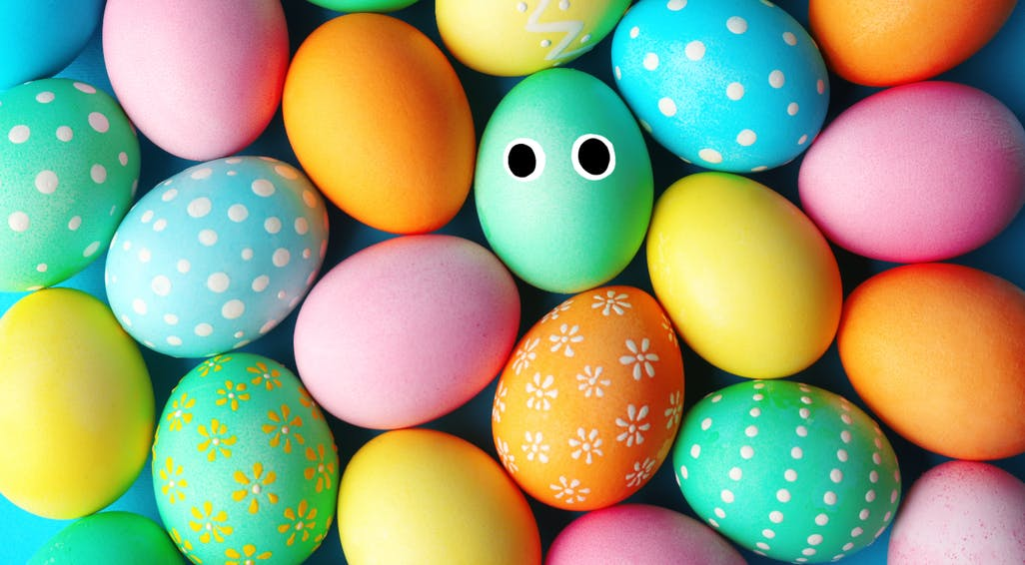
Easter quiz
Have fun and enjoy!

Slide 2
Round 1
Who are the famous faces?

Slide 3
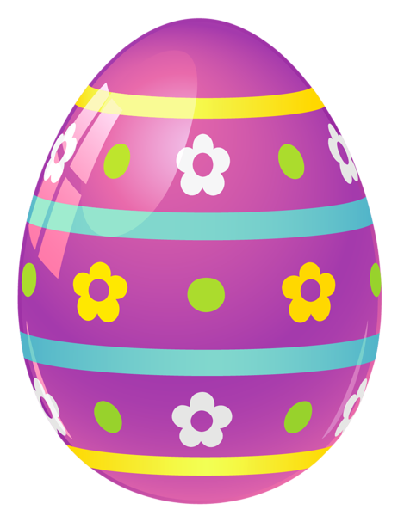
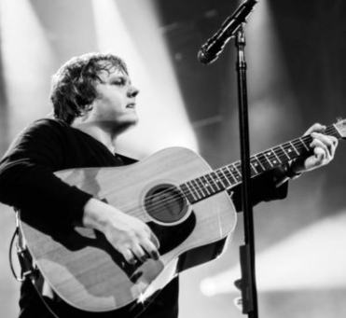
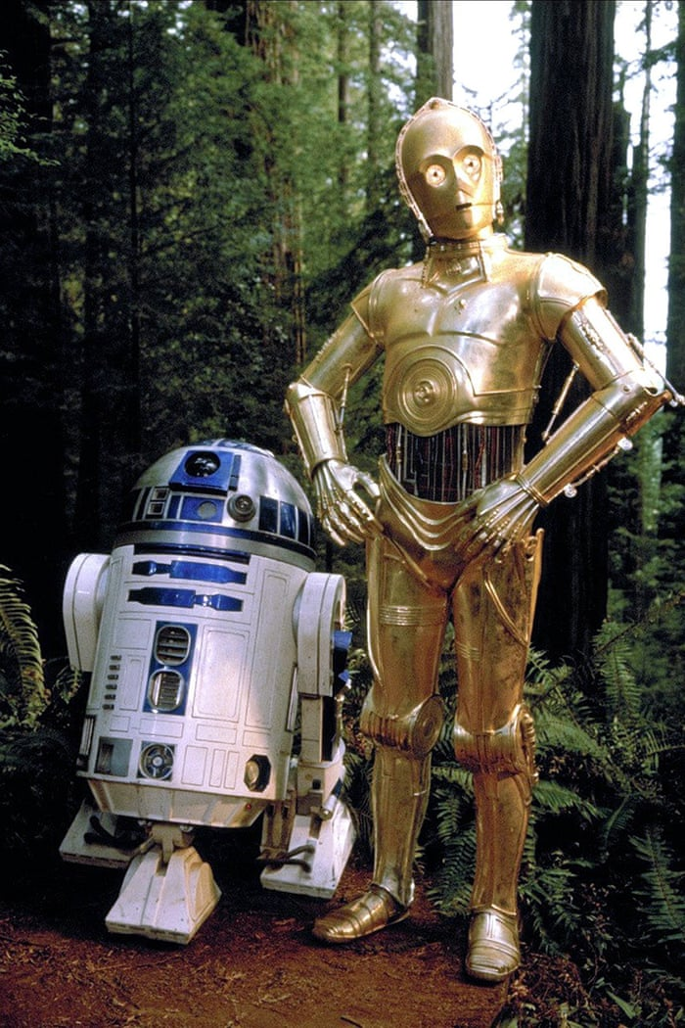
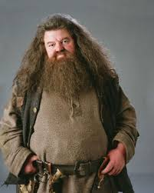
Guess the famous faces

Slide 4
Round 2
Easter facts

Slide 5
What are traditionally eaten on Shrove Tuesday?
A) Pancakes
B) Crepes
C) Drop Scones
D) Hot Cross Buns

Slide 6
Why are eggs associated with Easter?
A) Eggs symbolise Spring
B) Eggs symbolise Rebirth
C) Because chicks are the symbol of Easter

Slide 7
How do we know the date of Easter Sunday?
A) Cadburys choose the date
B) It is the Sunday after the first full moon after the Spring Equinox
C) It is the Sunday one month after Shrove Tuesday

Slide 8
Whereabouts is Easter Island?
A) Greece
B) Morocco
C) Chile
D) New Zealand

Slide 9
Why is it called Easter Island?
A) It is where Jesus was resurrected
B) It is where Easter was invented
C) It was discovered on Easter Sunday

Slide 10
Round 3
Easter puzzles

Slide 11
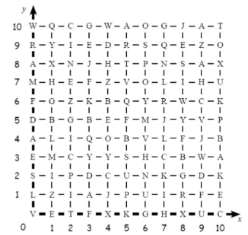
What is the Easter joke?
(7,0)(4,4)(0,10)
(4,9)(10,9)(10,1)(0,2)
(10,10)(7,0)(0,3)
(4,5)(0,8)(0,2)(5,8)(8,9)(8,1)
(1,5)(9,0)(6,2)(7,8)(6,6)
(2,0)(5,9)(0,4)(6,4)(10,1)(1,4)?
(3,5)(4,3)
(1,7)(3,1)(8,1)(4,5)-(6,7)-
(10,5)(7,7)(0,8)(6,2)(1,0)

Slide 12
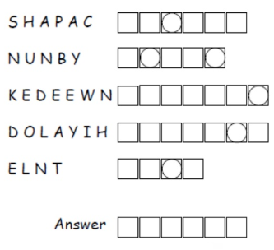
Unscramble the words.
The letters in circles, once unscrambled, make a word linked to Easter

Slide 13
Round 4
Chocolate challenge

Slide 14
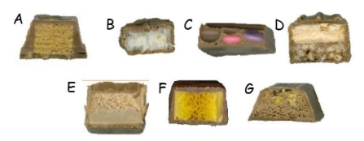
Name the chocolate bar

Slide 15
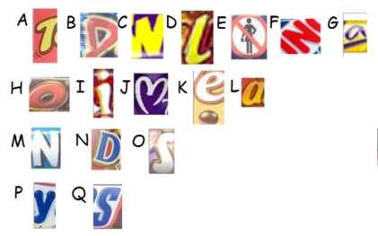
Name the chocolate bar

Slide 16
answers
only look when you’ve had a go at the quiz!!!

Slide 17
answers
Sure you’re not cheating??

Slide 18
Round 1
The Queen, Lewis Capaldi, Hagrid, R2D2 and C3PO
Round 2
Pancakes, Symbol of Rebirth, Sunday after the first full moon after Spring Equinox, Chile, Discovered on Easter Sunday
Round 3
How does the Easter Bunny travel? By Hare-o-plane!!
Pascha, Bunny, Weekend, Holiday, Lent
SUNDAY
Round 4
Kitkat Chunky, Bounty, Smartie Bar, Double Decker, Mars bar, Crunchie, Aero Honeycomb
Toffee Crisp, Drifter, Twirl, Lion Bar, Yorkie,
Nestle Crunch, Flake, Rolo, Picnic, Milk Tray, Revels, Caramac, Bounty, Daim Bar, Smarties, Milky Bar, Snickers

Slide 19
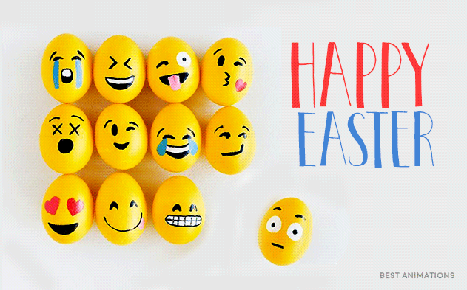
Love from mrs Elliott & miss Dunn xx

