Slide 1
La mode (Fashion)

Slide 2
Aim
I can write a range of sentences to describe other people.
Success Criteria
I can write sentences in the third person (he and she).

Slide 3
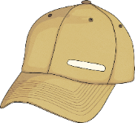
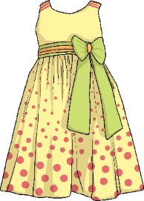
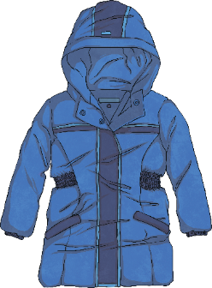
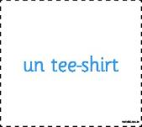
What Do You Remember?
Click play buttons throughout to hear phrases and words.
Can you remember the names of the clothes from last lesson?
Voici un chapeau.
Qu’est-ce que c’est ?
C’est une robe.
C’est un manteau.

Slide 4
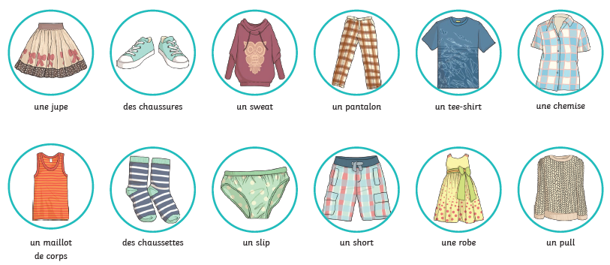
What Do You Remember?
Look back at the names of the clothes from last lesson
un pull
You may also have looked up some extra clothes words on word reference or in a dictionary

Slide 5
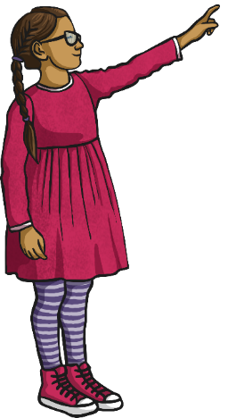
Posez la question (Ask the Question)
Je porte une chemise, un manteau, un pantalon et des chaussures.
Qu’est-ce que tu portes ?
This question means:
What are you wearing?
The person answers using:
Je porte = I am wearing

Slide 6
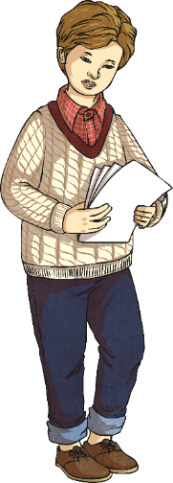
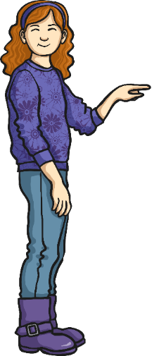
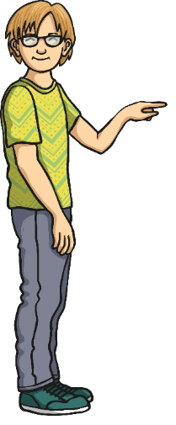
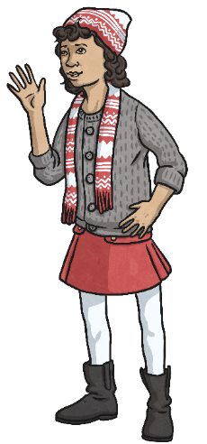
Posez la question (Ask the Question)
To ask about other people, we need to change the pronouns from ‘I’ and ‘you’, to ‘he’ and ‘she’.

Slide 7
Il porte… (He’s Wearing…)
Il porte un pull, une chemise, un pantalon et des chaussures.

Slide 8
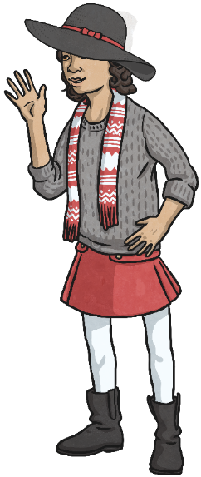
Elle porte… (She’s Wearing…)
Elle porte un chapeau, une écharpe, un pull, une jupe, des collants, et des bottes.

Slide 9
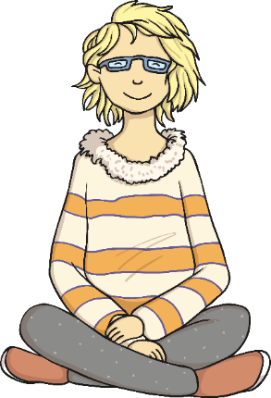
La grammaire (Grammar Point)
What could you say about this girl?
She’s wearing glasses.
Elle porte des lunettes.

Slide 10
La grammaire (Grammar Point)
What else could you say about this girl?
She’s wearing trousers.
Elle porte un pantalon.
Task:
Using the sheet, glue or draw a picture of a person into each of the boxes. Think about is the person male or female? Have a mix of both! Can you write sentences to describe what the person iswearing, using either ‘Il porte…’ or ‘Elle porte…’ Could you draw yourself and describe what you’re wearing in French?

Slide 11
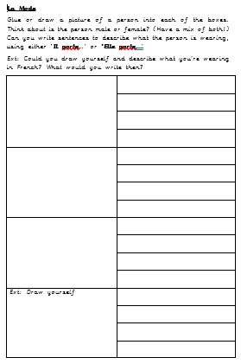
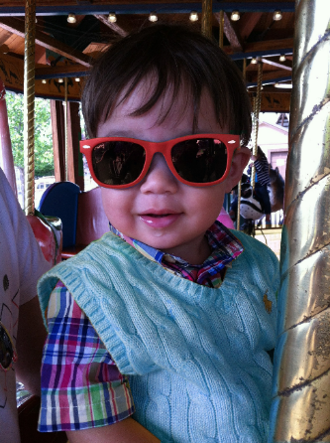
Dessinez-le (Draw It)
Elle porte un tee-shirt et un short.
Il porte des lunettes et un pull.

