Slide 1
The Sacred Thread Ceremony (Upanayana)

Slide 2
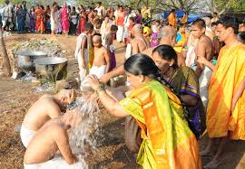
Upanayana means ‘sitting close by’
The ceremony starts with head-shaving, bathing and wearing new clothes. Hindu boys used to go through this ceremony from as early as the age of 8 but now, it happens when a boy is almost a teenager. It is thought of as being ‘twice born’.

Slide 3
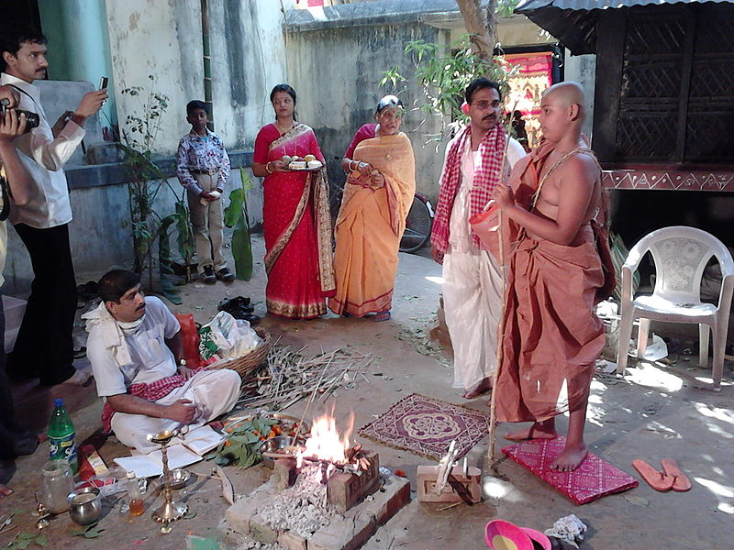
The Havan
A ‘havan’ or sacred fire is lit, and a Hindu priest says hymns from the Vedas (a holy book).

Slide 4
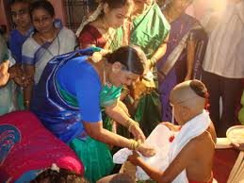
Begging for alms (money or gifts)
One of the Upanayana traditions is to ask your mother to give money or gifts.

Slide 5
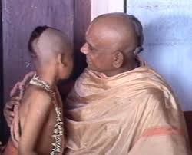
The guru or priest whispers the Gayatri mantra
A guru is a spiritual teacher and the Upanayana is about taking shelter from your guru. The guru (often this is the boy’s father) whispers a special prayer into the boy’s ear. The boy must say it three times every day. It marks the beginning of a religious lifestyle.

Slide 6
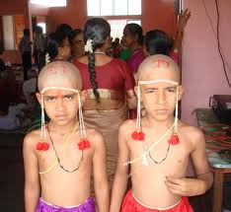
The Jenoi – the Sacred Thread
The boy has a sacred thread draped over his left shoulder. It has 3 strands to remind the boy of his duties to:
God
To his ancestors
To his guru.

Slide 7
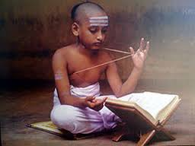
The Vedas – Holy Books
The boy has to promise to study the Vedas (holy books of the Hindu religion).
Then he gives a present to his teacher (guru).

Slide 8
Hindu rites of passage
Jatakarma – birth ceremonies
Upanayana – initiation (the sacred thread ceremony)
Vivaha – marriage
Antyeshti – funeral and rites for the dead
Are these similar to rites of passage in other religions?

