Slide 1
Goodnight Mister Tom

Slide 2
Starter: Listen to this sound and look at the images (you don’t have to watch the full video)
https://www.youtube.com/watch?v=erMO3m0oLvs&t=103s
After listening, discuss the following:
What is this sound?
What do you think people had to do when they heard it?
What have you noticed about the images?
Select three emotions you might hear when hearing that sound.

Slide 3
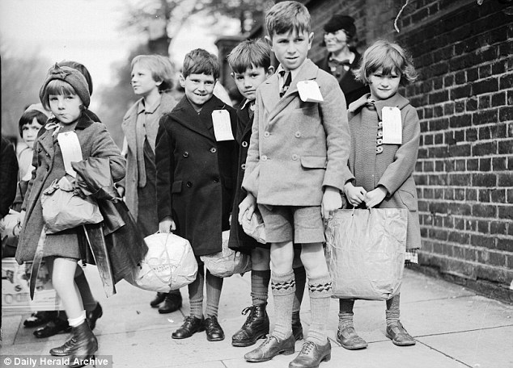
https://www.youtube.com/watch?v=voUe1WFBD9Q
What are the children doing? Why?
What do you notice about their appearance?
How does their environment change in the photos on the video?

Slide 4
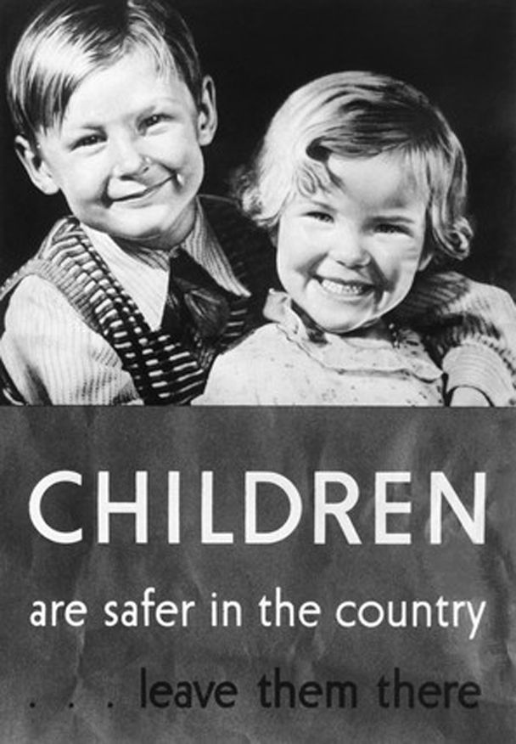
What does evacuation mean?
Who had to be evacuated?
Where did they go? Why there?
What is your view of evacuating children and why do you think that?

Slide 5
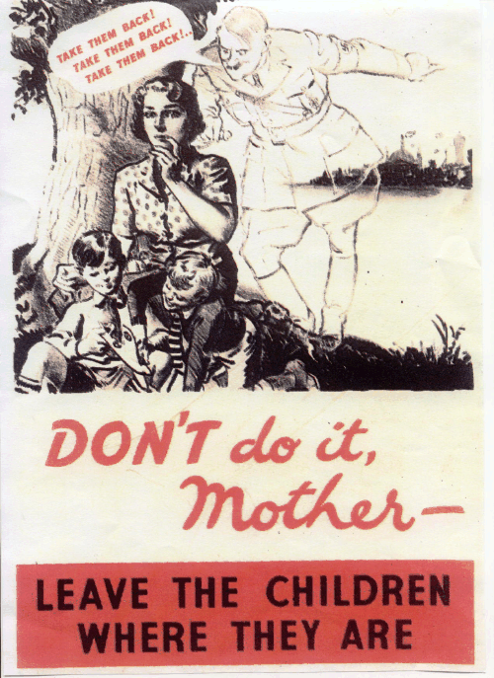
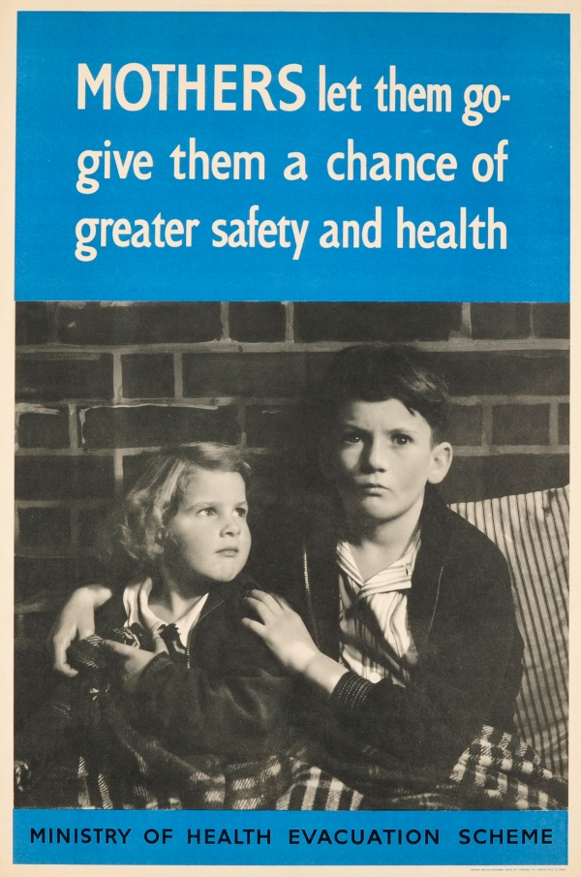
What is your view of these government posters and why?

Slide 6
Look at the evacuee label
Name: William Beech
Home: London
Destination: Dorset
What predictions can you make about our main character?

Slide 7
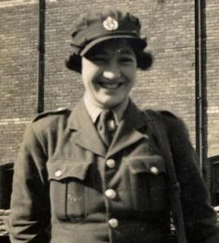
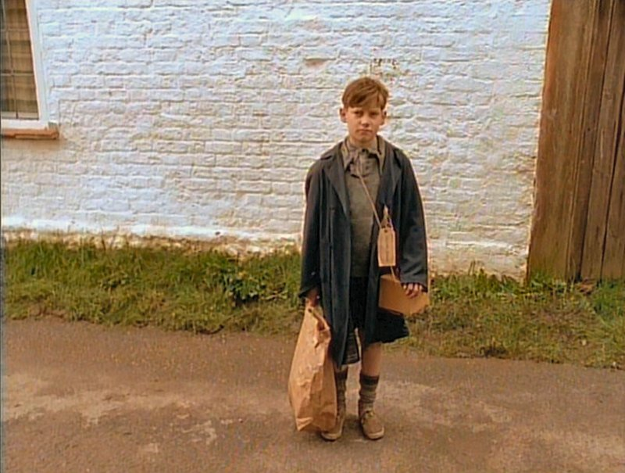
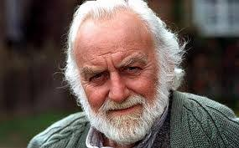
Chapter 1.
This is a long chapter with lots of key information in it so listen carefully. Make notes about Willie and Tom as the story is being read to you.
Think about their background, diet, behaviour, personality, experiences.
Billeting Officer
Willie
Tom

Slide 8
Task
What clues in the text can tell you about their pasts?
How do Willie’s and Tom’s past experiences relate to each other?

Slide 9
https://www.bbc.co.uk/teach/class-clips-video/history-ks2-an-evacuees-adventure/zk7hy9q
Discuss how children must have felt whilst being evacuated from their homes.
Positive Feelings
Negative Feelings

