Slide 1
PROPAGANDA
LO: To understand what propaganda posters were used for during WW2.

Slide 2
What is
propaganda?
Dictionary definition:
Information, especially of a biased or misleading nature, used to promote or publicise a particular point of view.

Slide 3
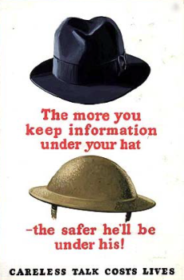
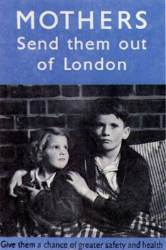
Propaganda posters
Propaganda posters appeared in many public places during WW2 to send important messages to people.
Look at the poster on the next slide and answer the following questions.....

Slide 4
What message is this poster trying to get across?
Who is this poster aimed at?
Why was it so important that people took notice of this poster?
Do you think using a poster was an effective way to get this message across?

Slide 5
Today’s Task
Cut out the propaganda posters on the worksheet.
One by one, stick them into your book and write a short explanation as to what the purpose of each one was during WW2.

